Slide 1



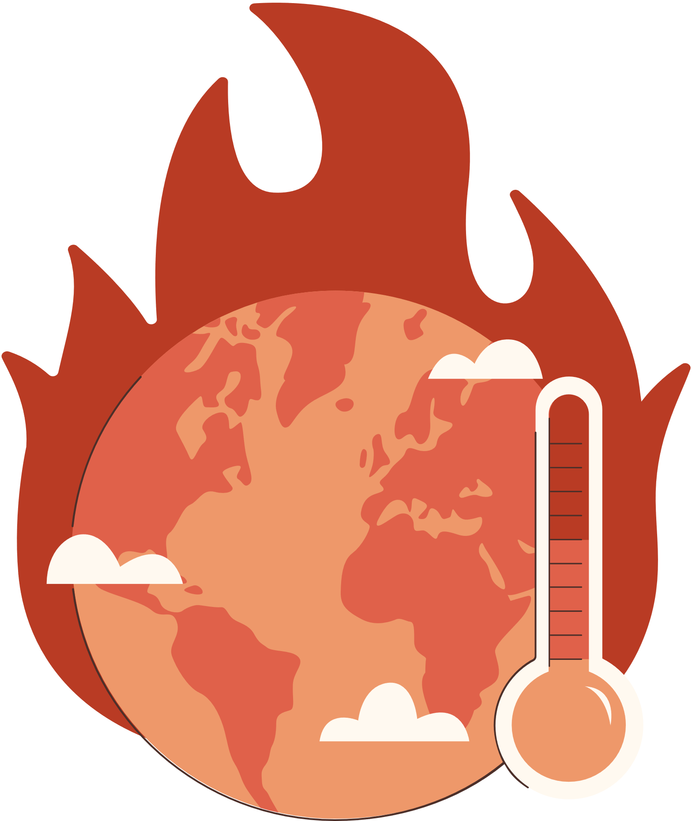

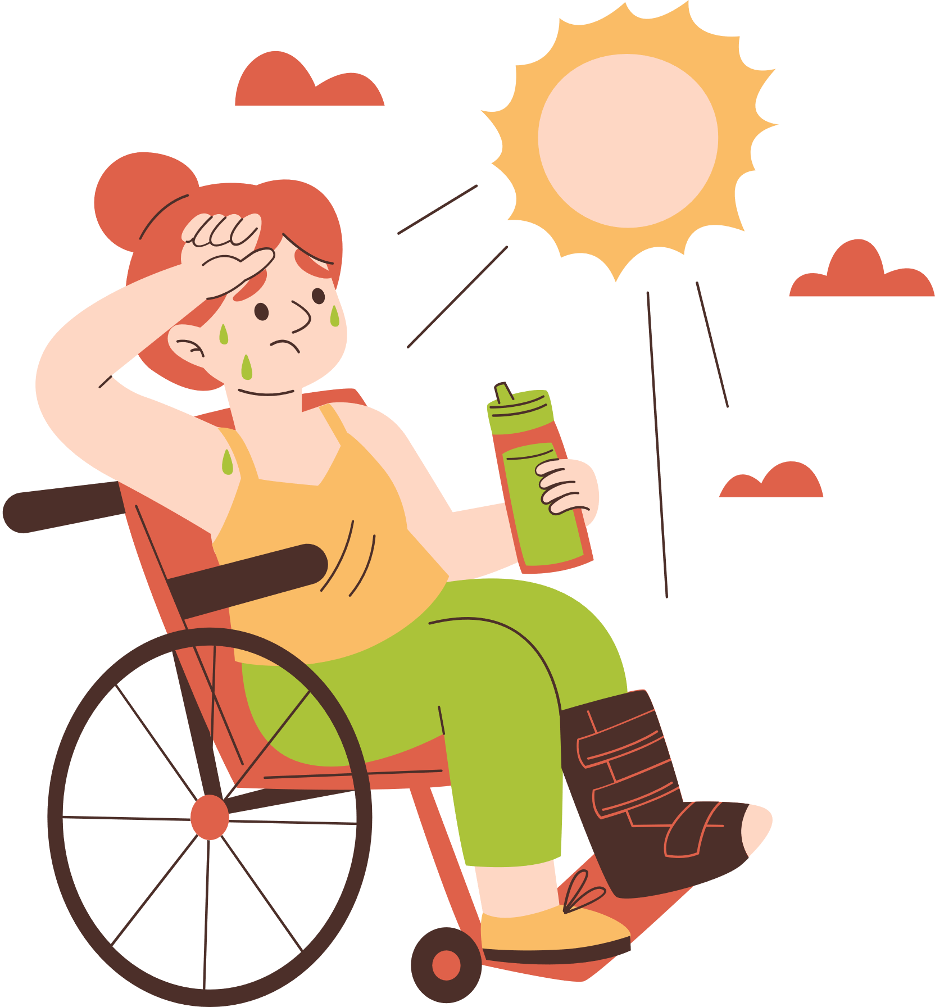
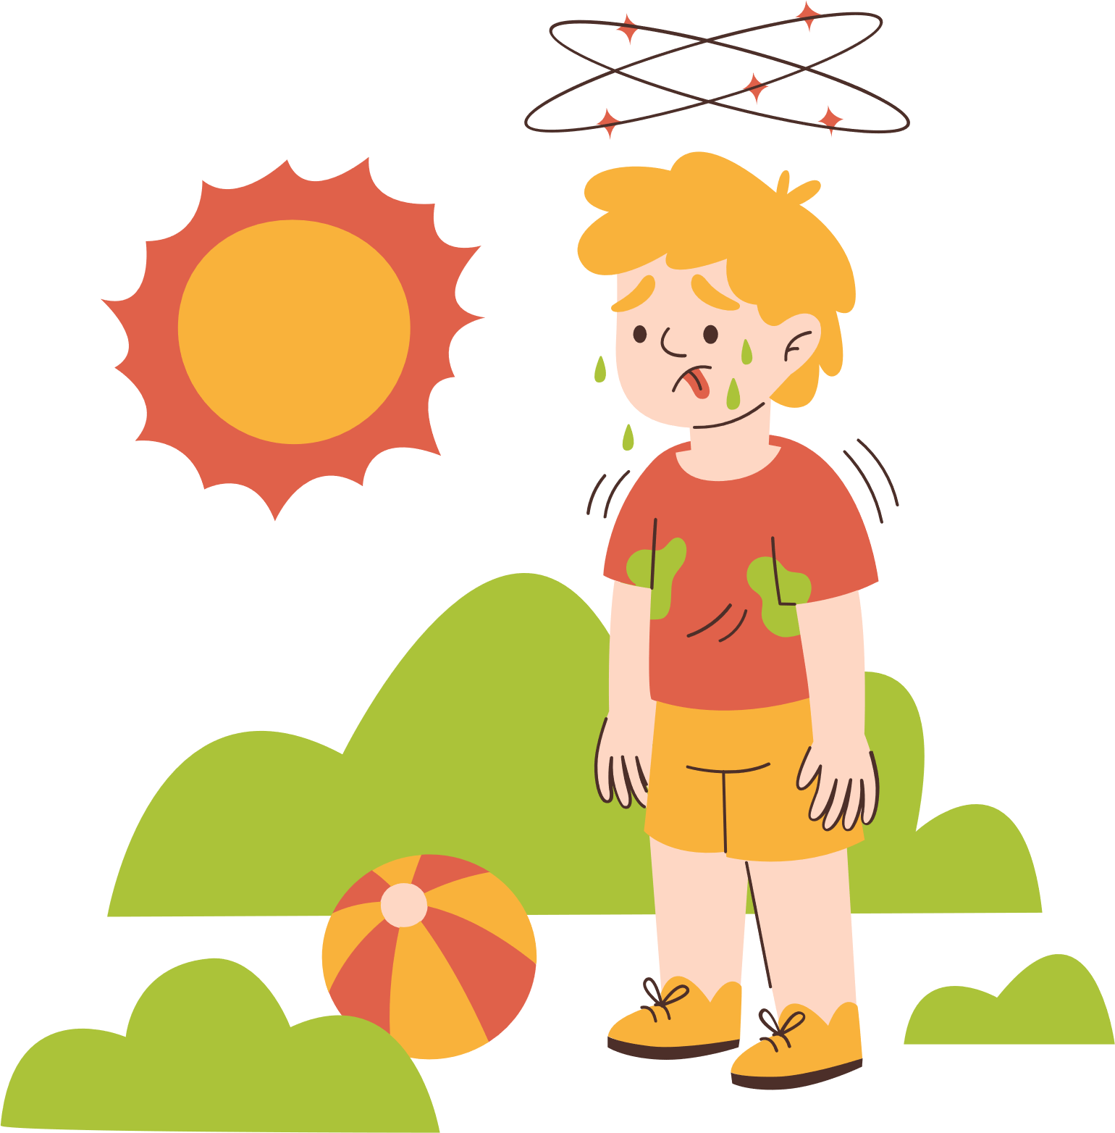

Climate Change
Understanding the Impacts and Taking Action

Slide 2







Let's discuss the impacts of climate change on our planet and the steps we can take to address them.

Slide 3


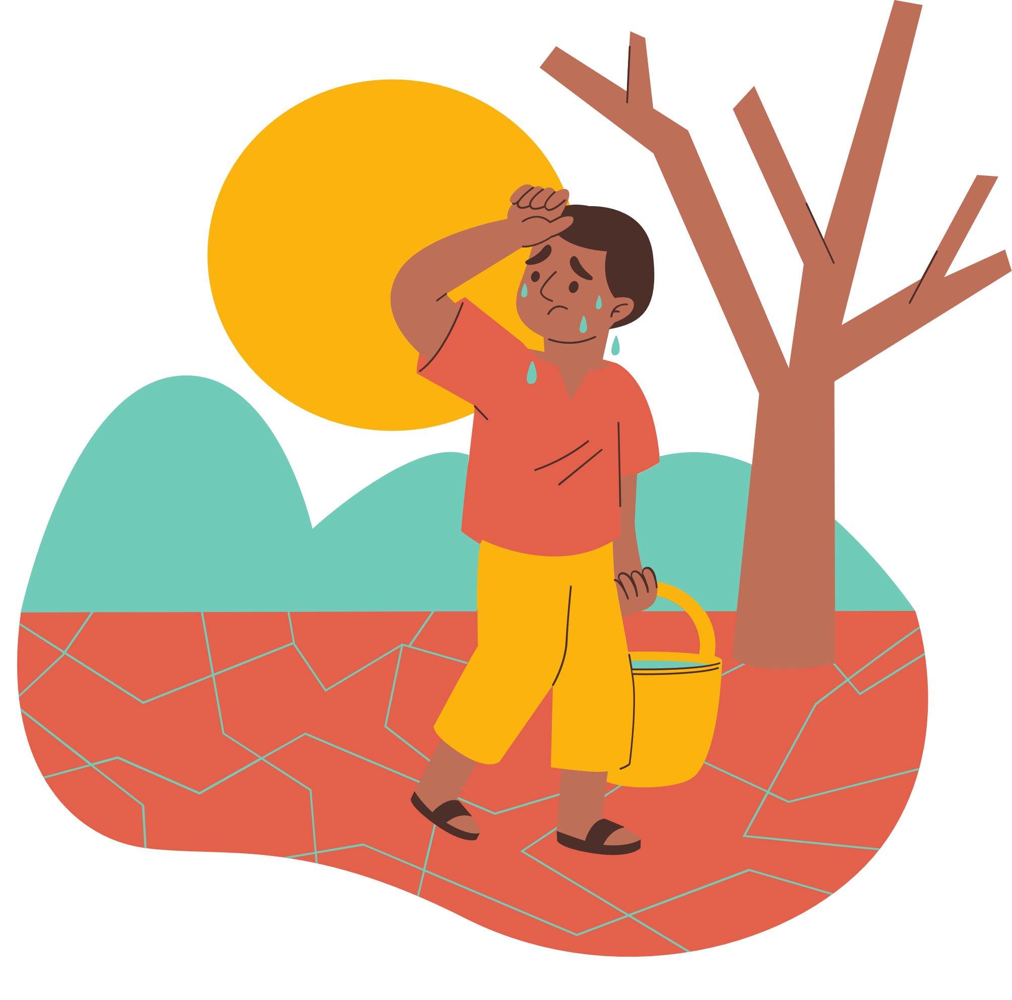



Table of Contents
  What is Climate Change?
  Causes of Climate Change
  Environmental Impacts
  Renewable Energy
  Mitigation Strategy
  Adaptation Strategy
  City of Windsor Initiatives

Slide 4



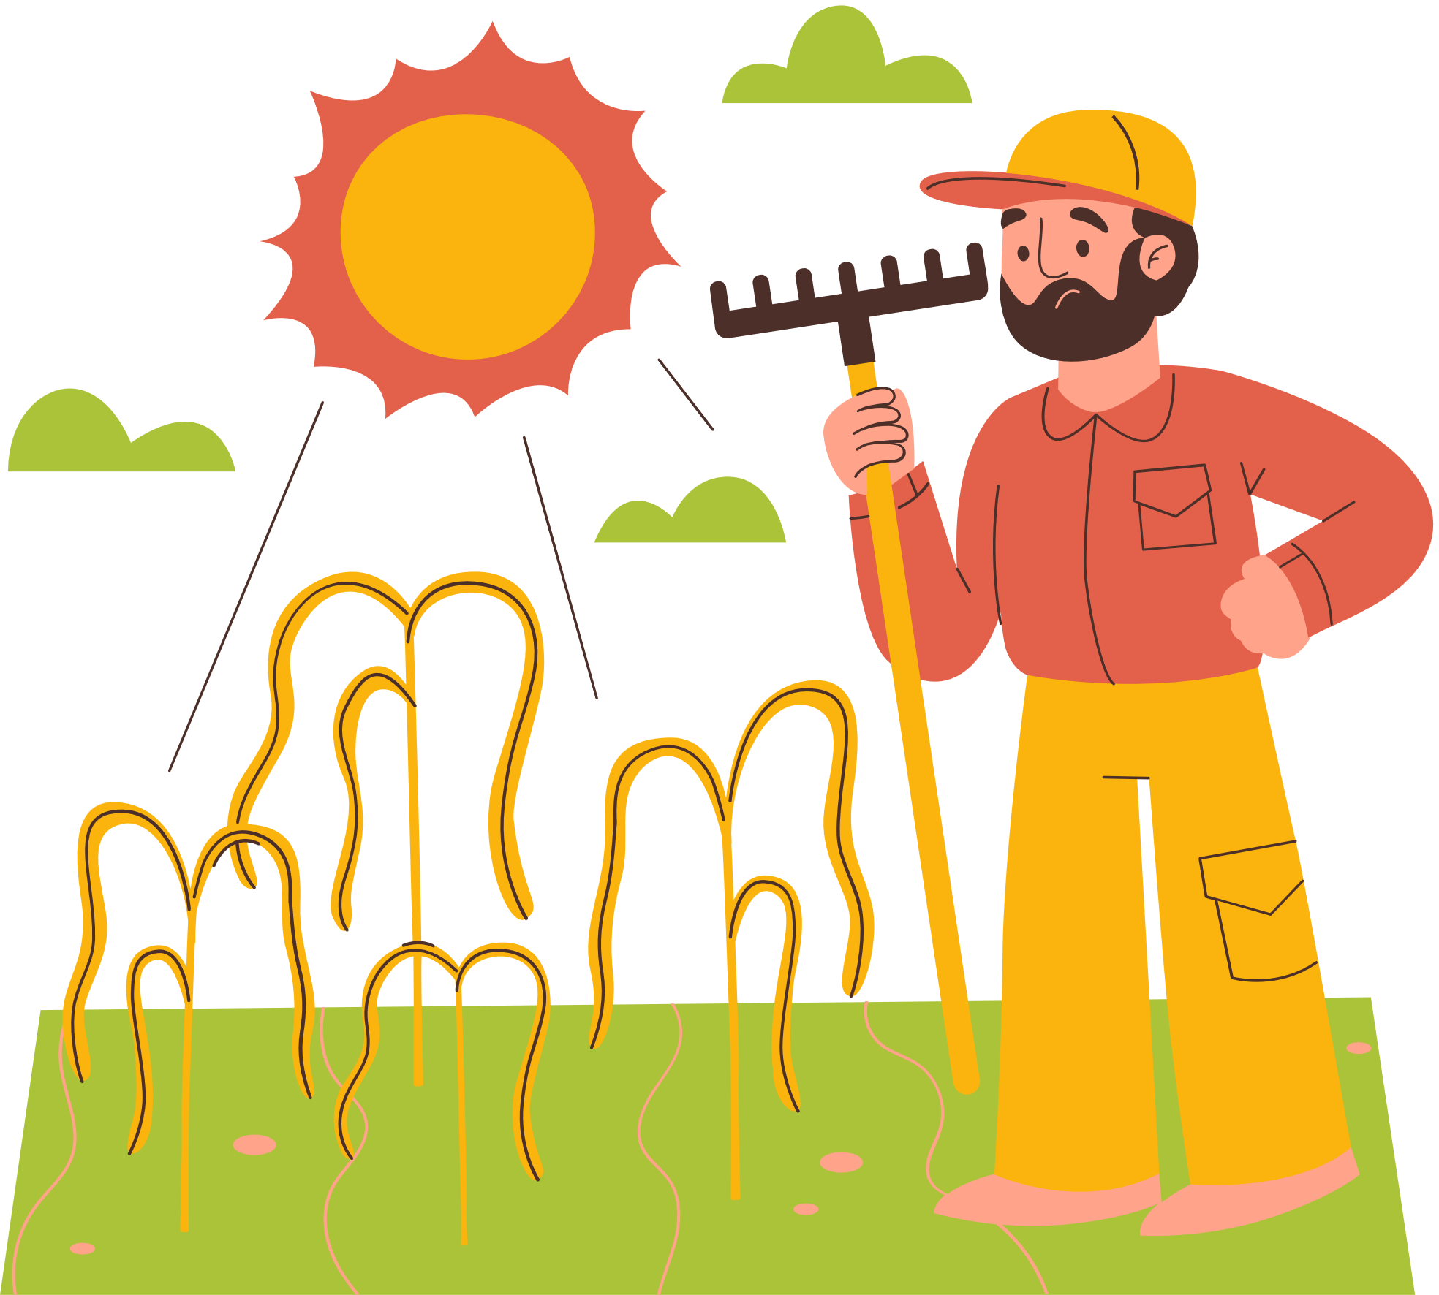

What is Climate Change?
Climate change refers to long term changes in weather conditions around the world. While these changes can occur naturally, human activities such as the burning of fossil fuels are accelerating this process significantly.

Slide 5

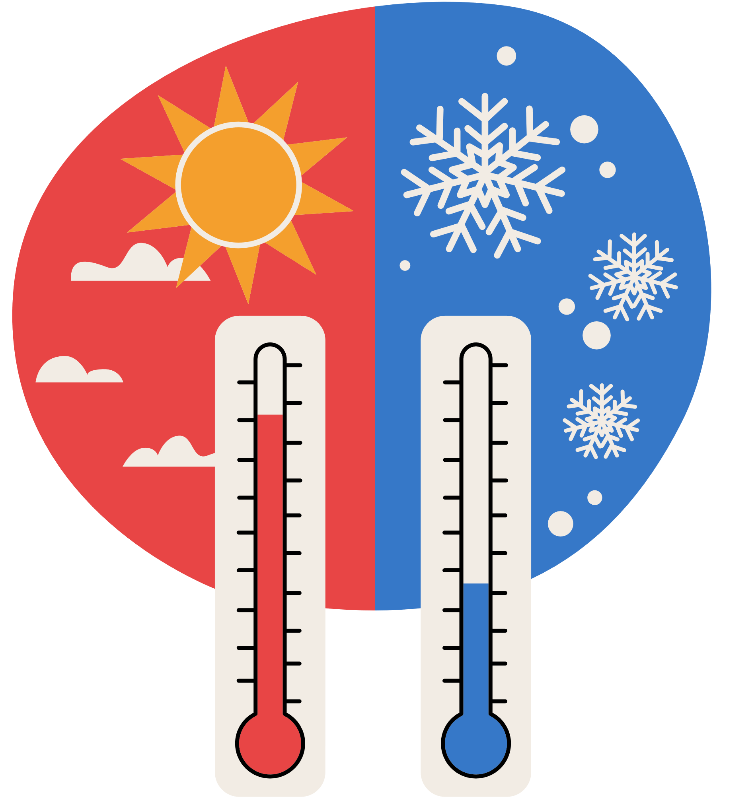





Temperature vs Climate
Temperature is like the outfit you wear today. It changes based on the weather
Climate is like your whole wardrobe. It’s the collection of clothes you have because of the kind of weather your area usually has over the year
For example, if you live in a warm place, your wardrobe might have lots of summer clothes. If you live somewhere cold, you probably have lots of sweaters and jackets. Climate change is like realizing your wardrobe isn’t working anymore because the weather patterns have changed.

Slide 6




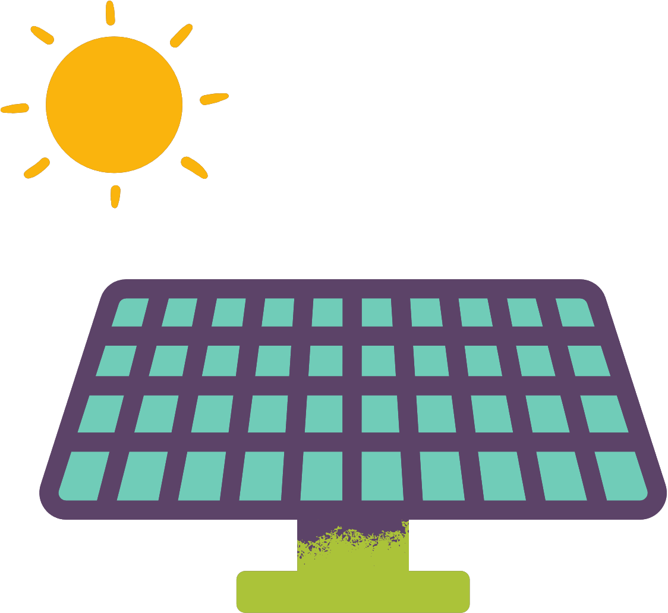

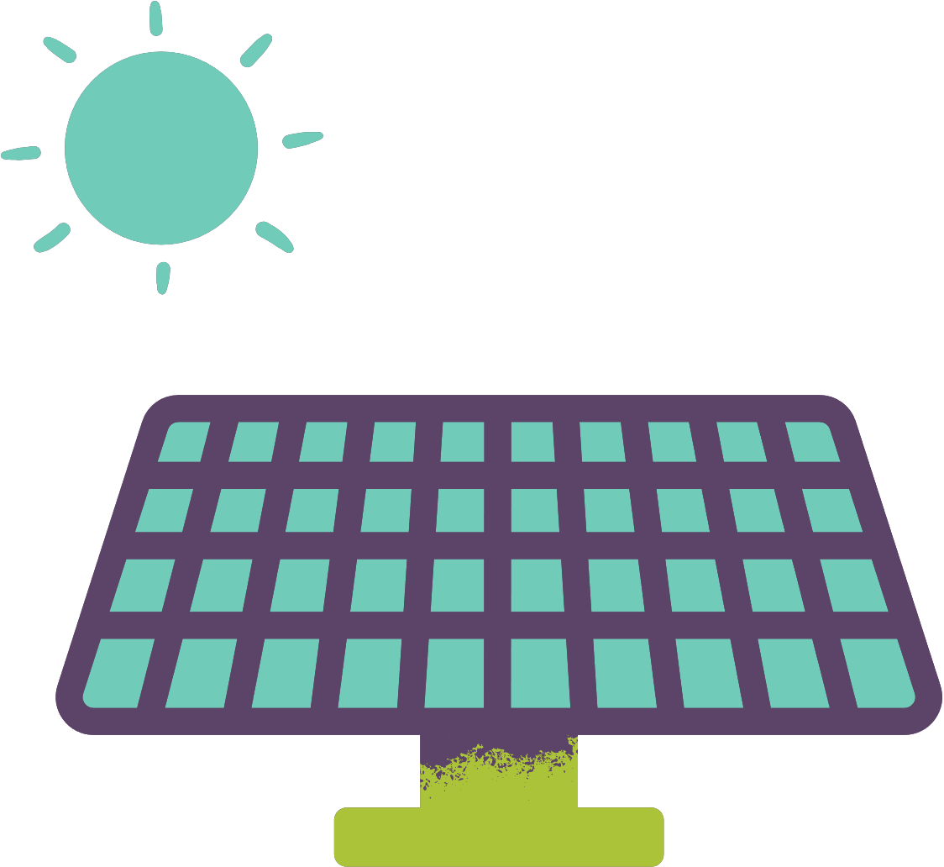

Question 1:
True or false: climate is a gradual change in weather patterns?

Slide 7
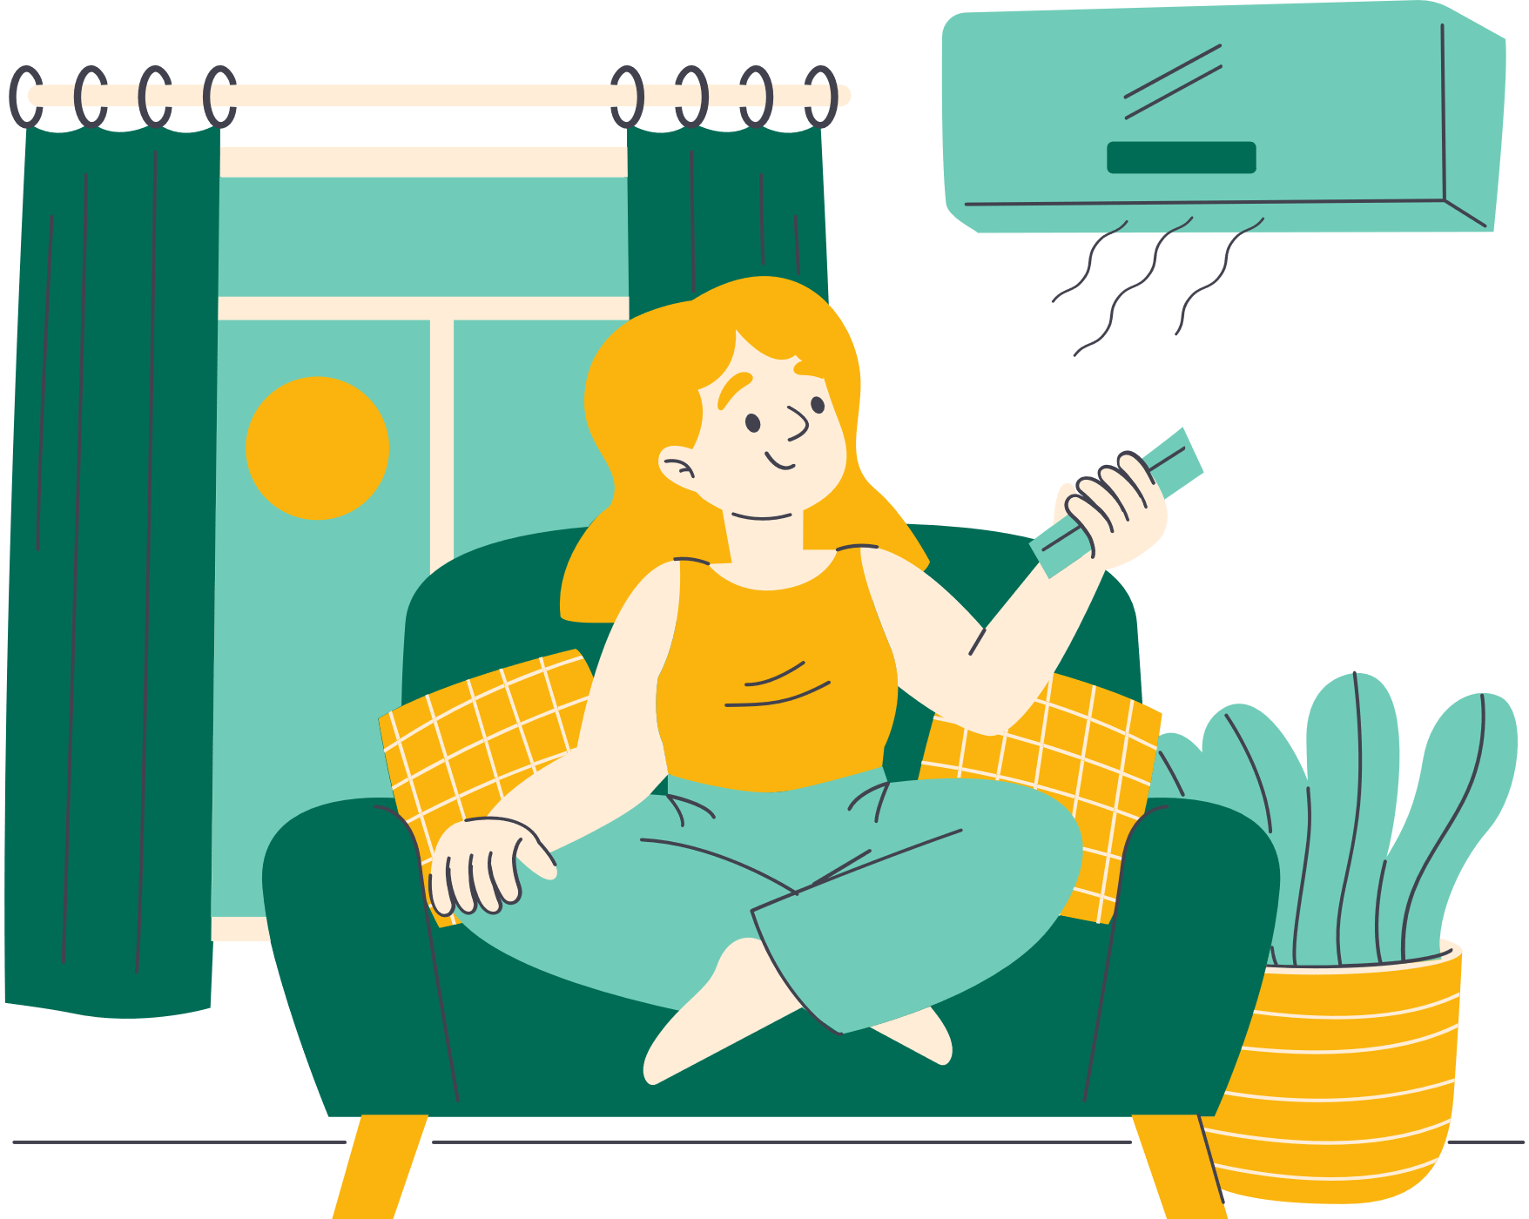
Causes of Climate Change
The main cause of climate change is the increase in greenhouse gas emissions such as carbon dioxide (CO2) and methane (CH4). The main sources include the burning of fossil fuels, deforestation, and intensive agriculture.

Slide 8
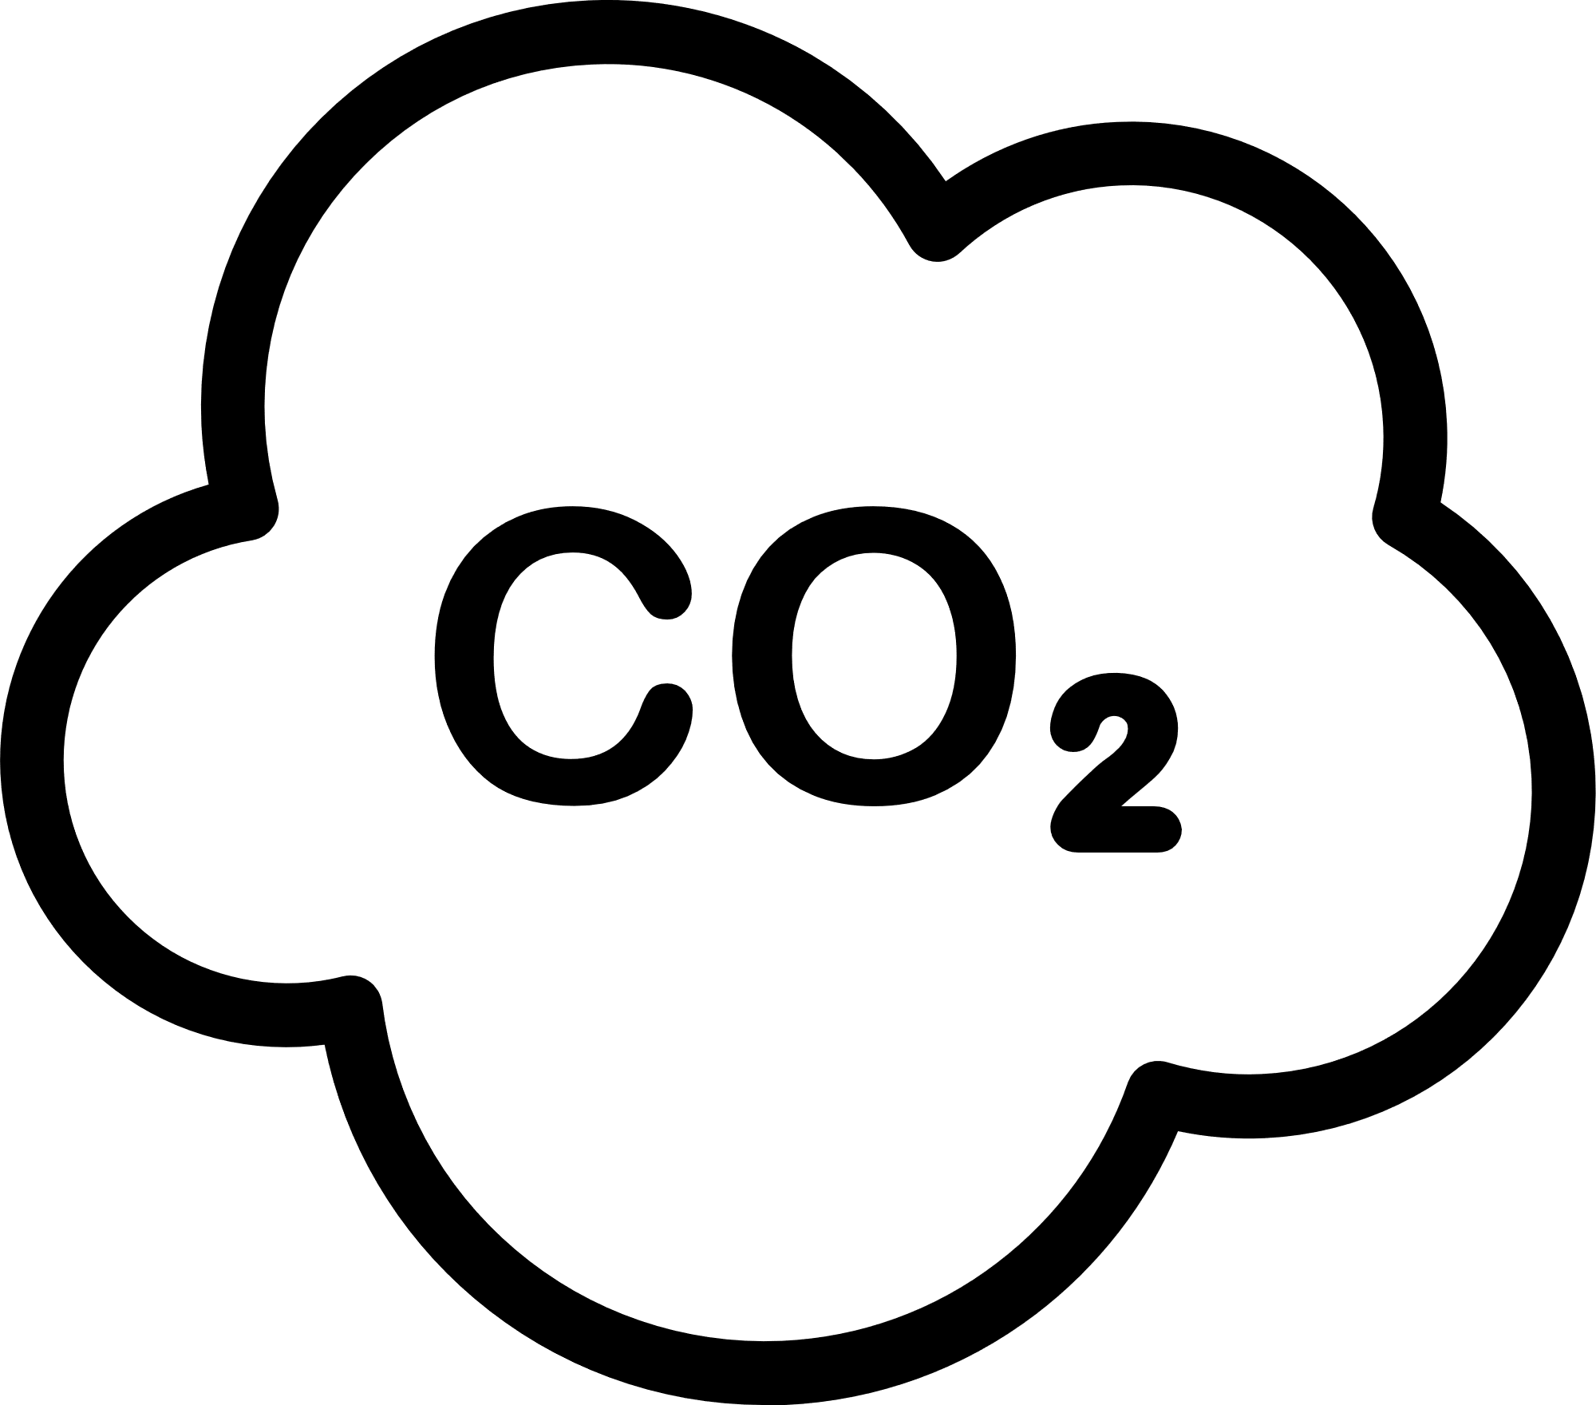
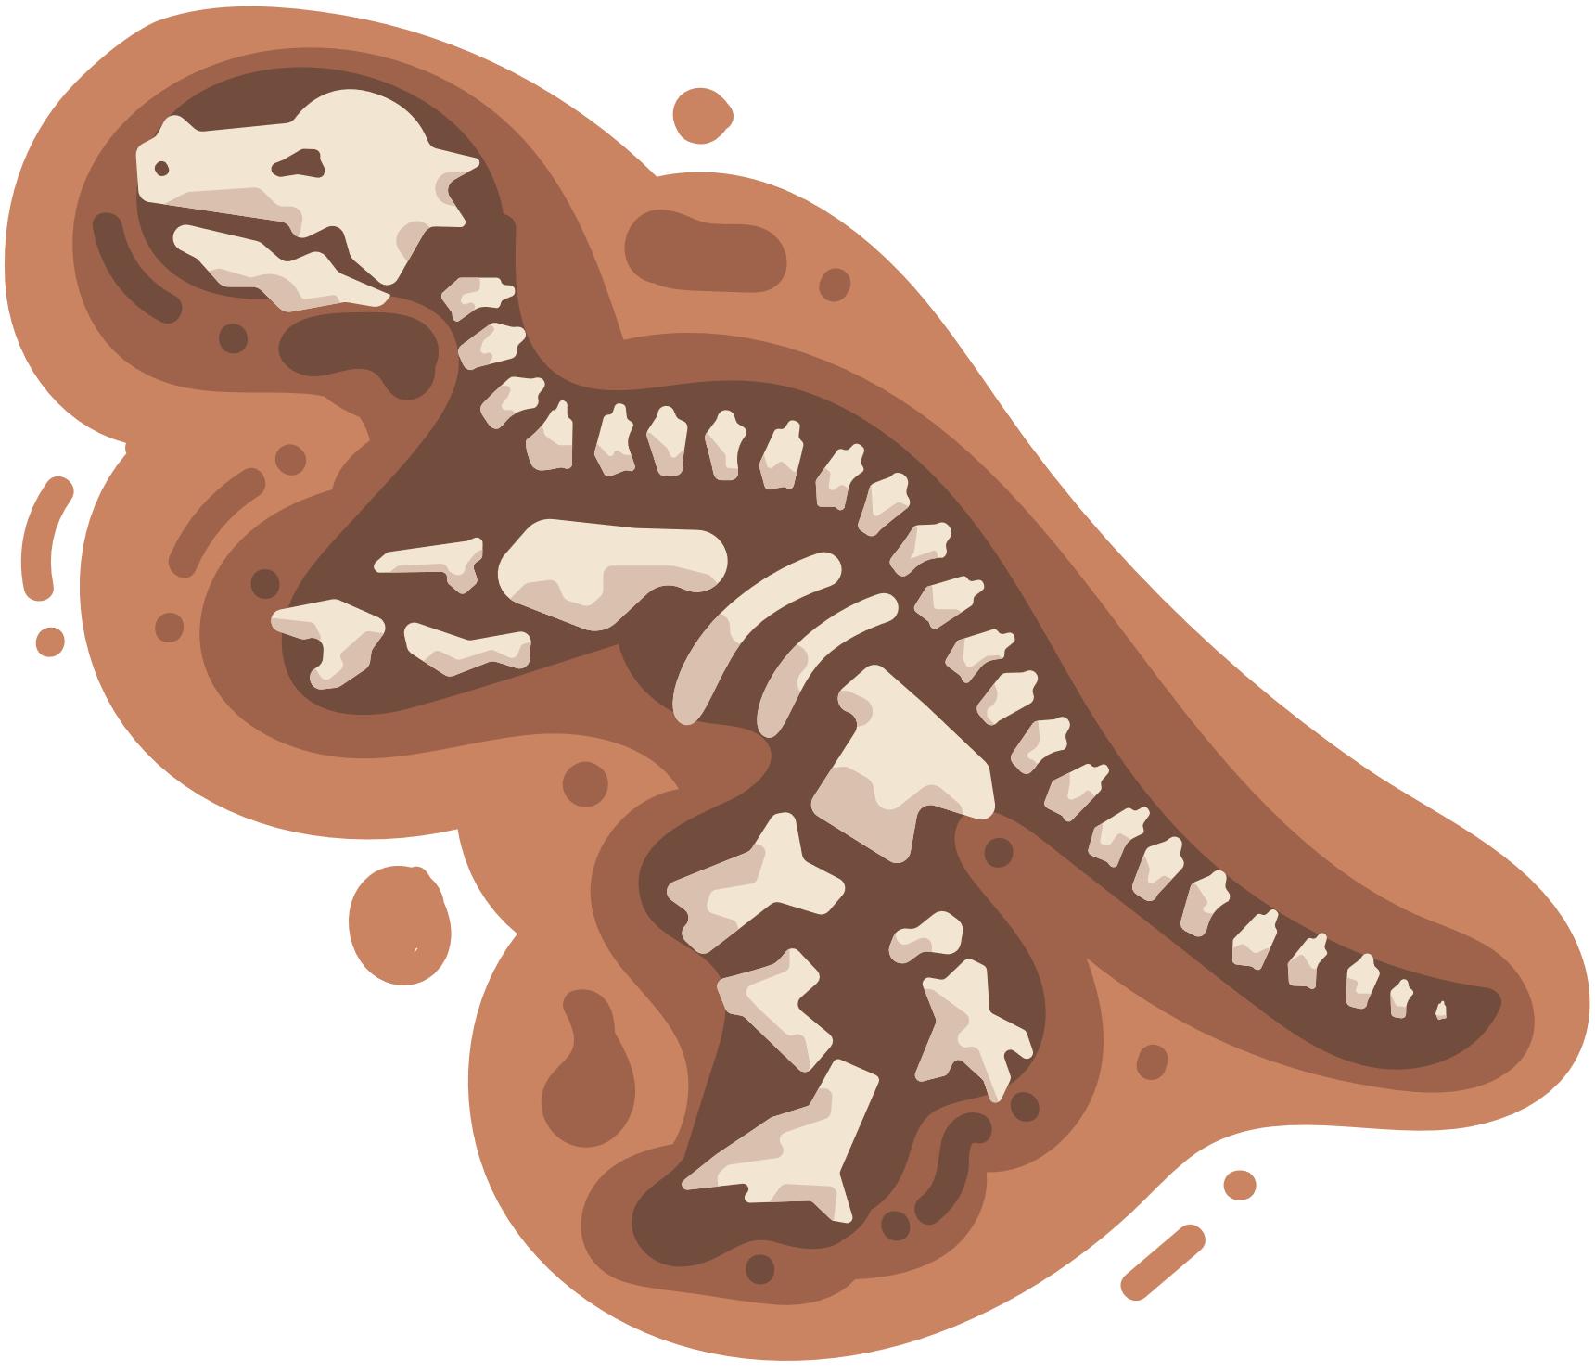

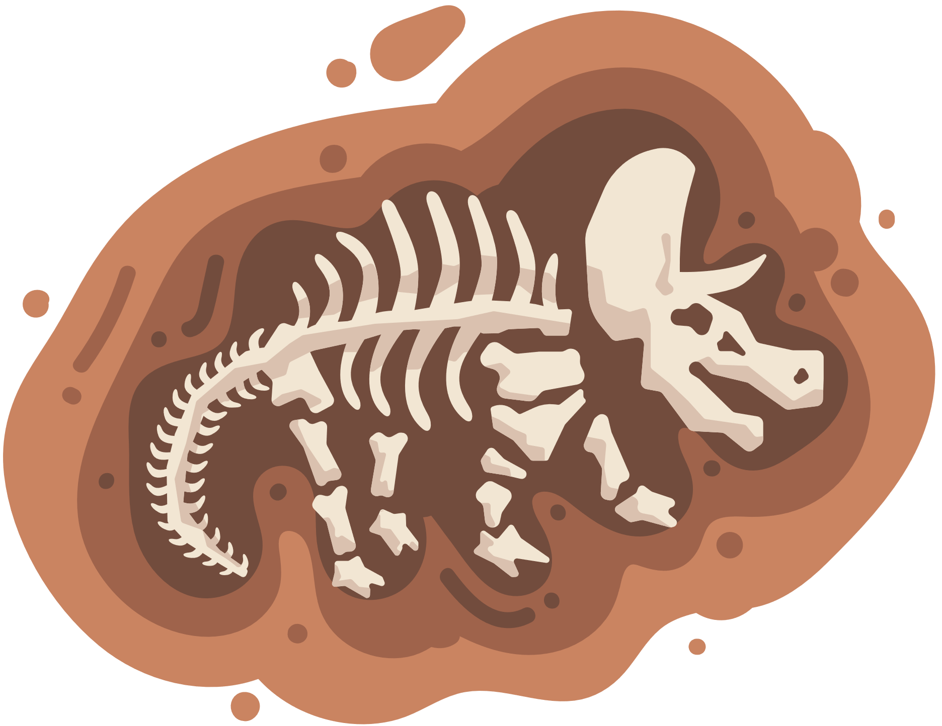
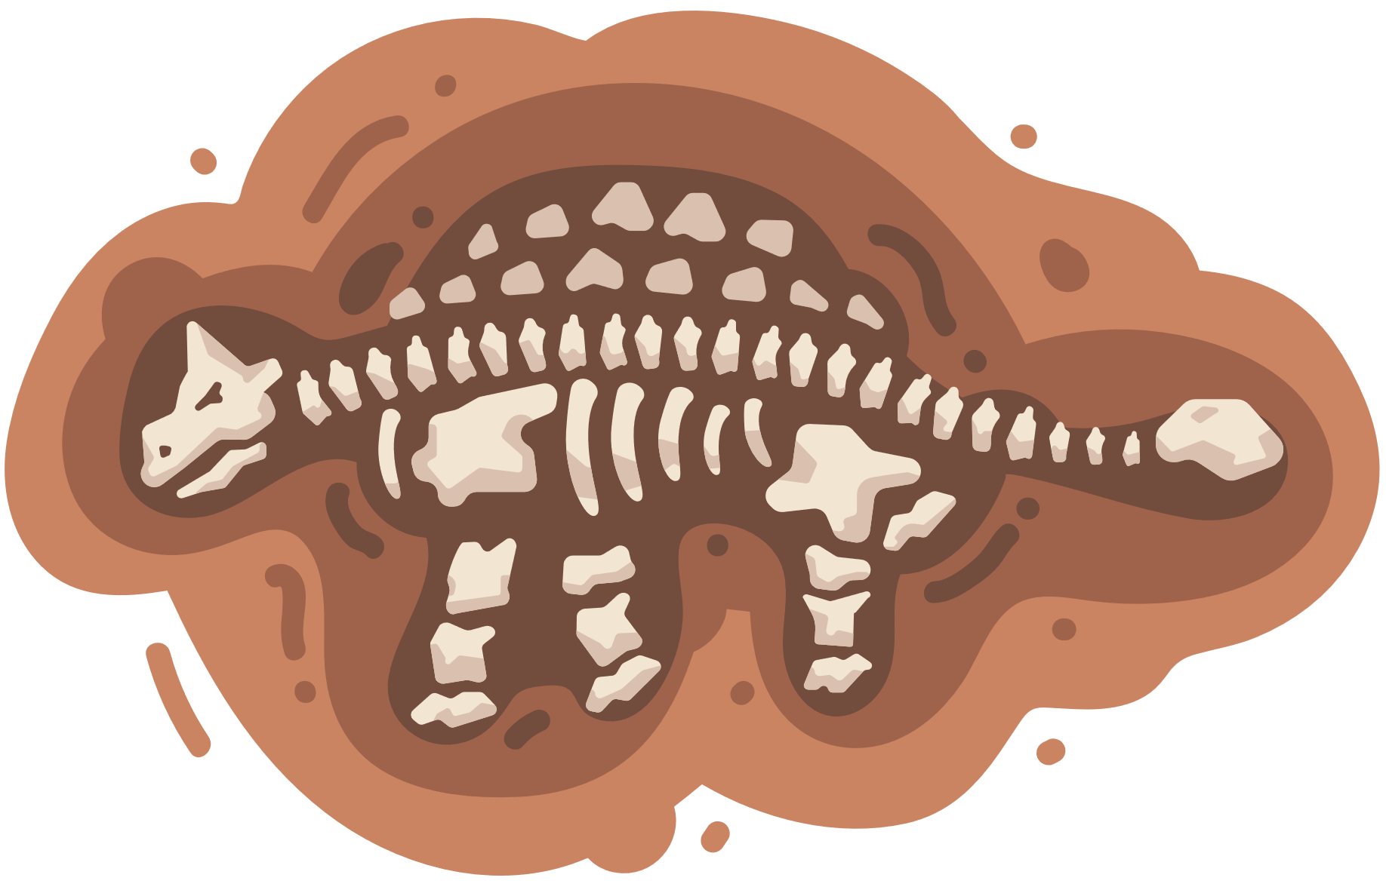
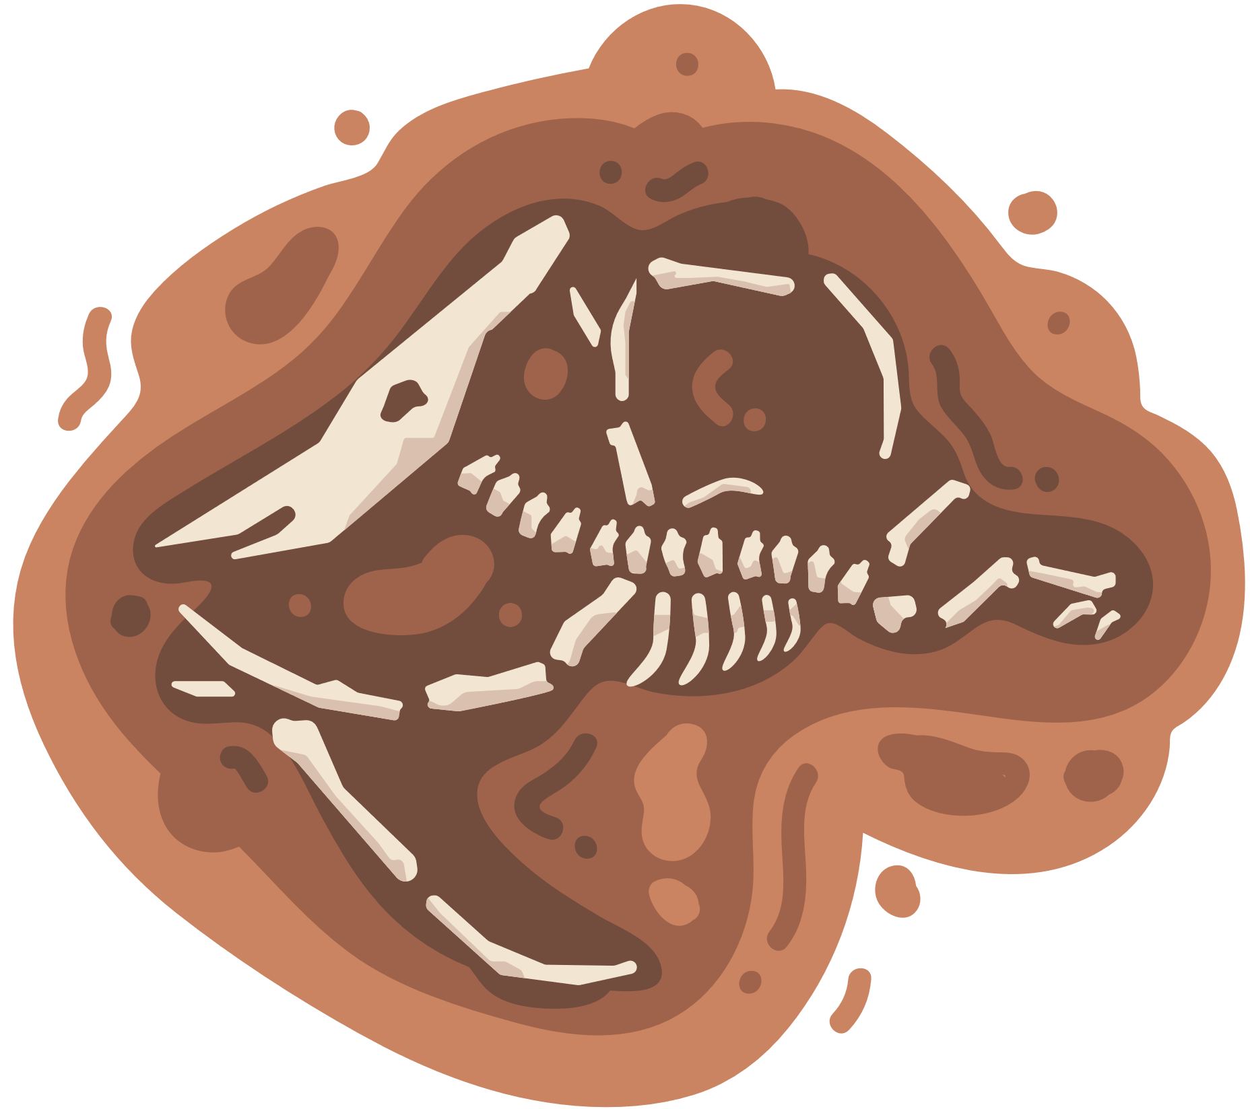
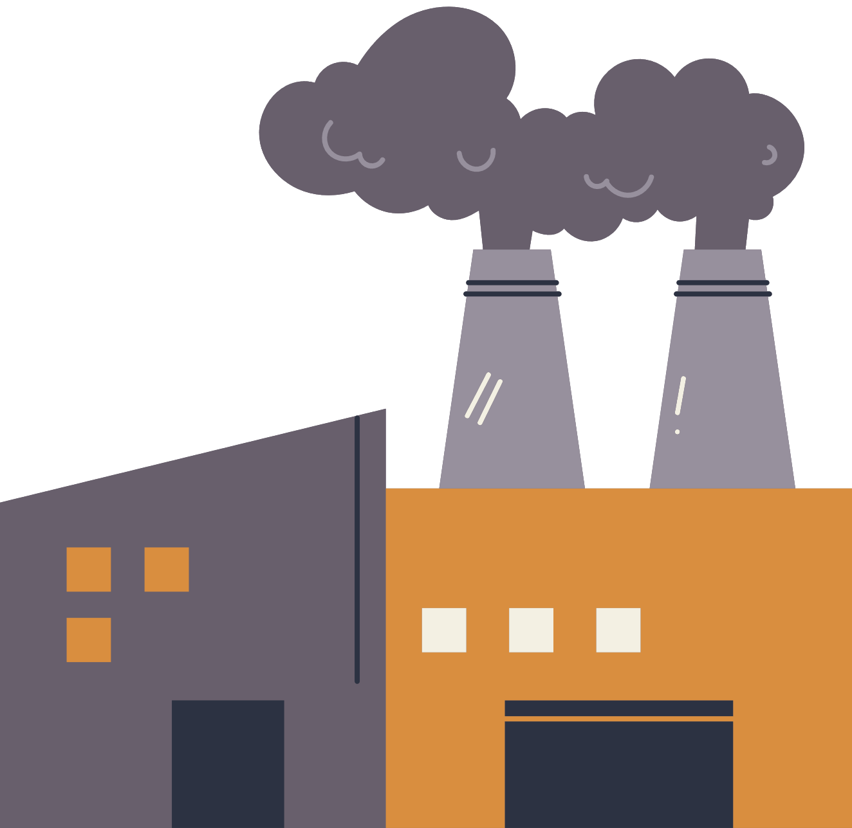

What are fossil fuels?
Fossil fuels are energy sources like oil, coal and natural gas. We use these to drive our cars, heat our homes/schools and provide light.
Fossil fuels are formed as ancient animals buried under the ground decompose. Using these resources pollutes the earth, intensifying climate change.
It takes a million years to create fossil fuels, but only seconds to burn them.

Slide 9

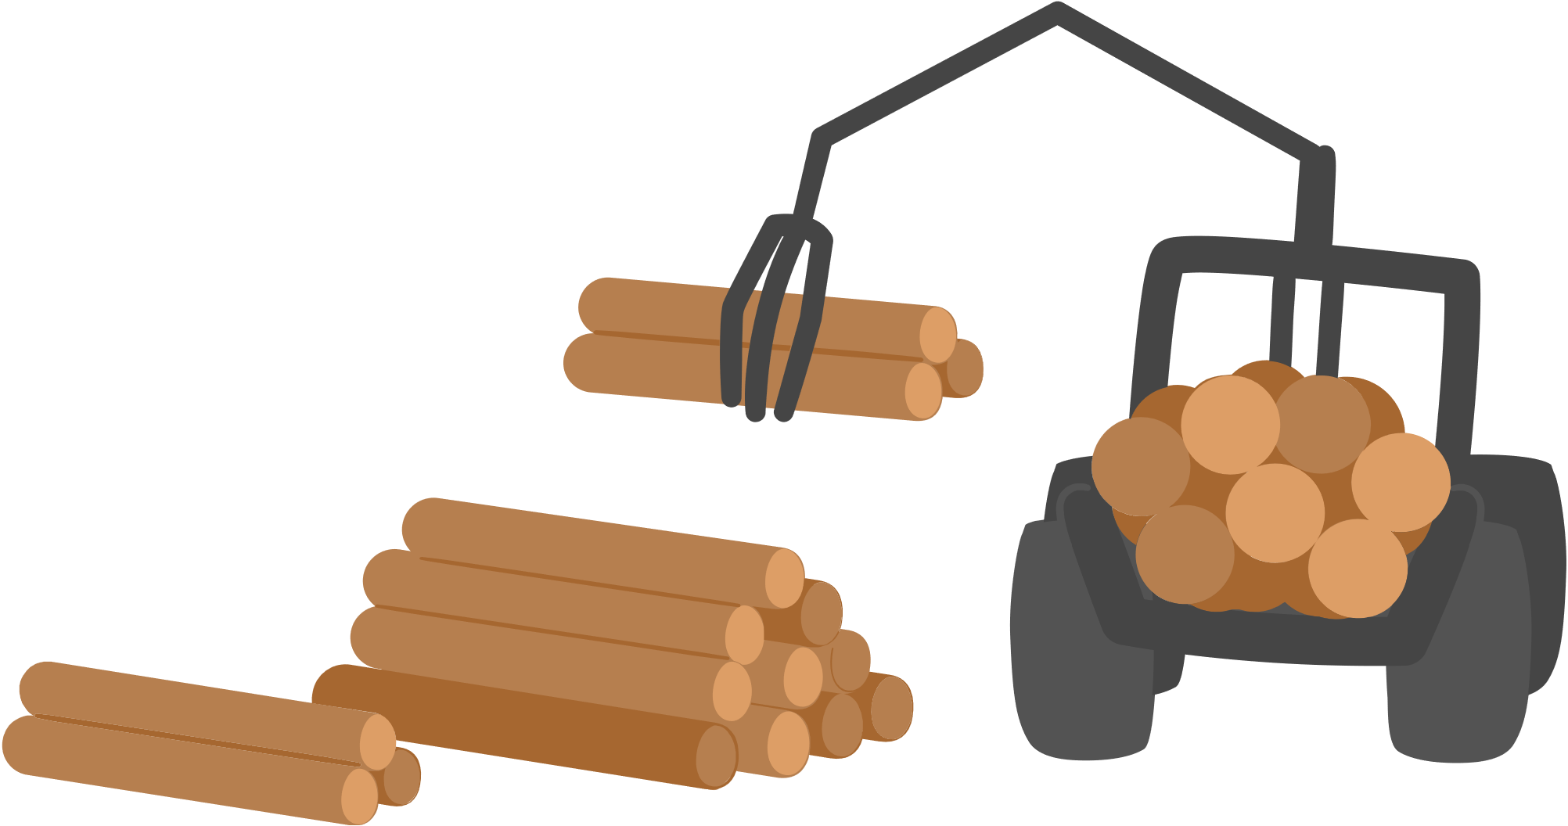
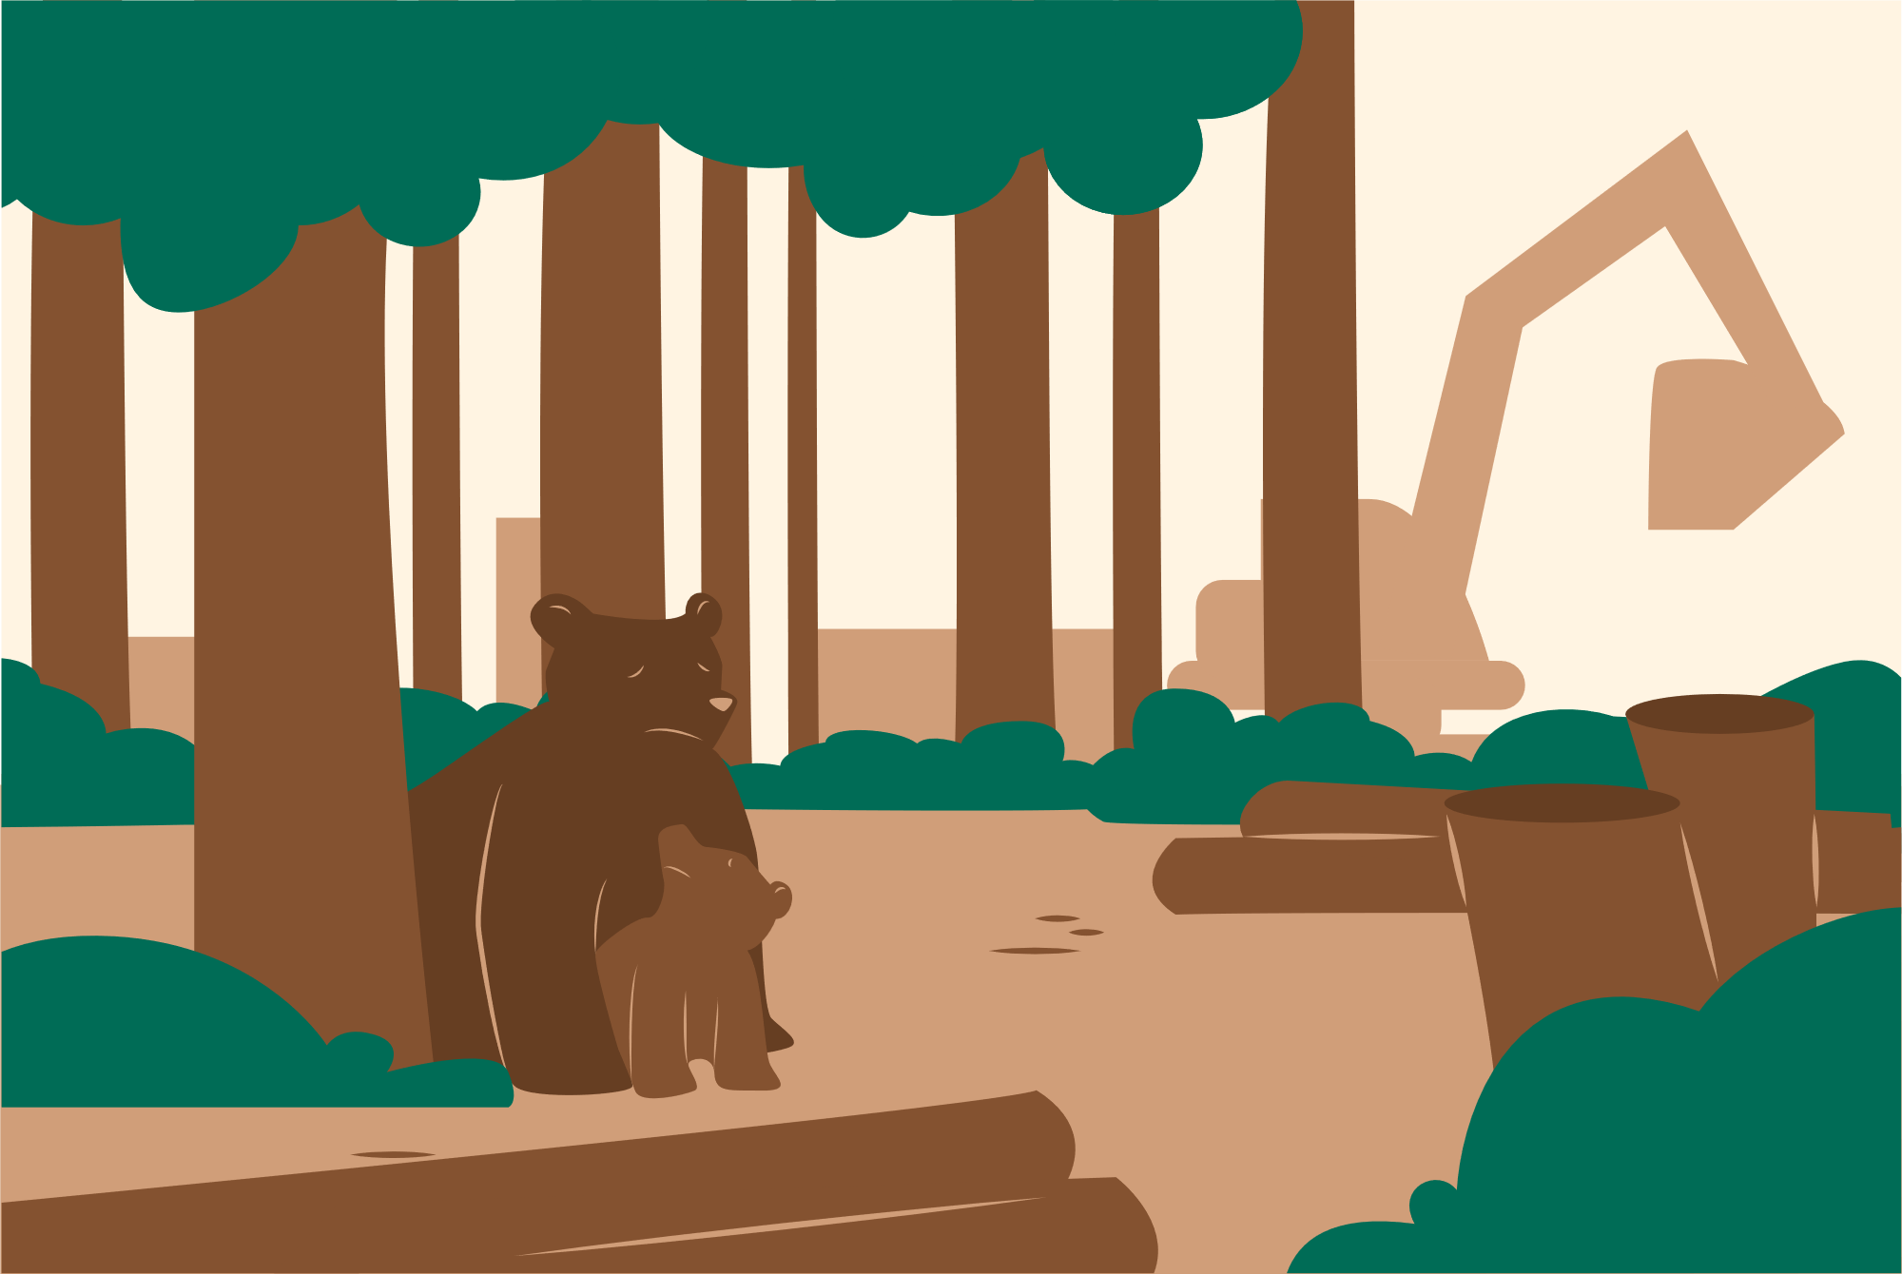
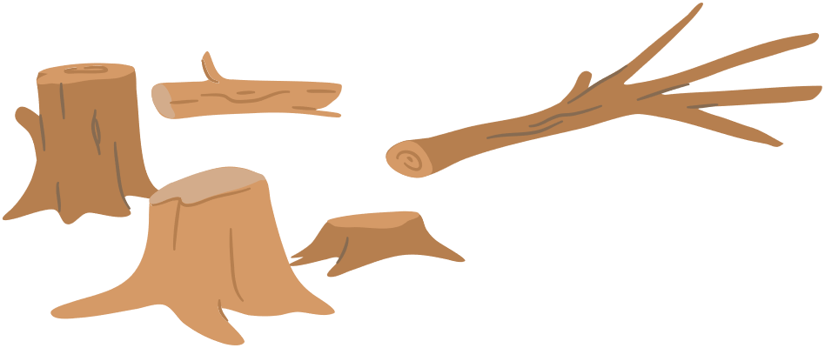
Deforestation
Deforestation is the act of cutting down large quantities of trees for industry like paper and cardboard. Trees keep large quantities of CO2 trapped in their leaves and branches, helping reduce climate change effects. Cutting down trees results in large quantities of CO2 being released into the atmosphere and a loss in animal habitats.

Slide 10




Question 2:
Which of the following is not a main source of climate change?
Intensive Agriculture
Flooding
Burning of Fossil
Fuels
Deforestation

Slide 11
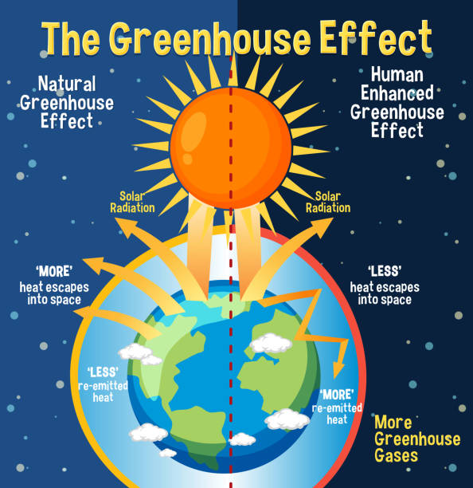
How climate change works? Greenhouse Gases
Greenhouse gases, like carbon dioxide (CO₂), methane (CH₄), and water vapor, act like a blanket around the Earth. They trap heat from the sun, which keeps our planet warm enough for us to live. This process is called the greenhouse effect. However, when we burn fossil fuels, cut down trees, or farm in certain ways, we release extra greenhouse gases into the atmosphere. This traps more heat than normal, making the Earth warmer over time.

Slide 12
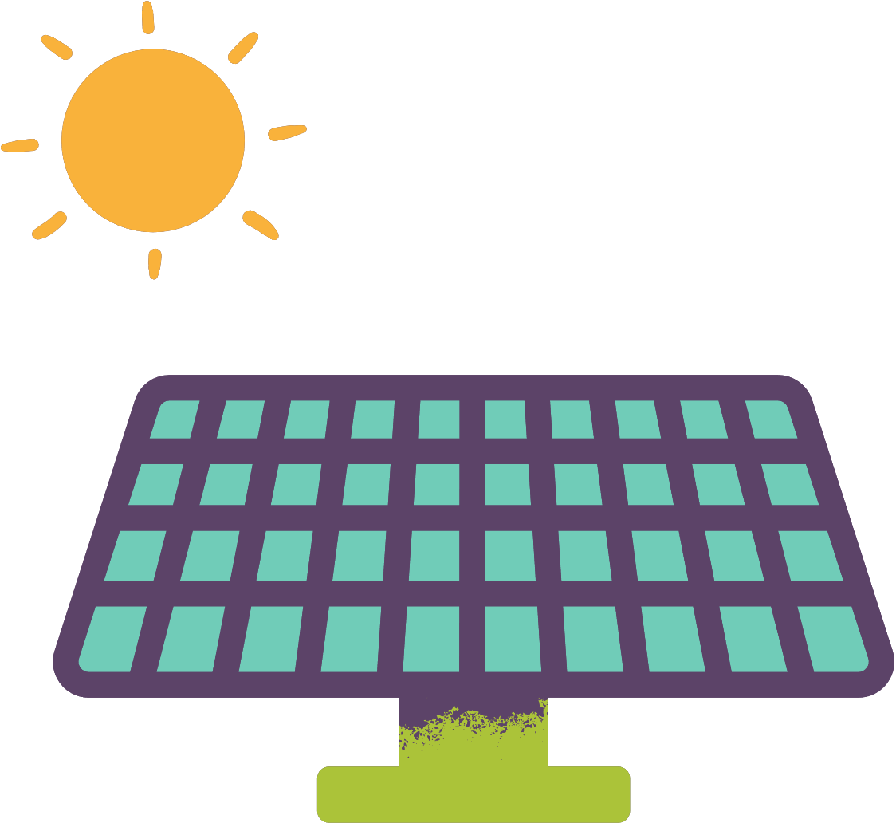

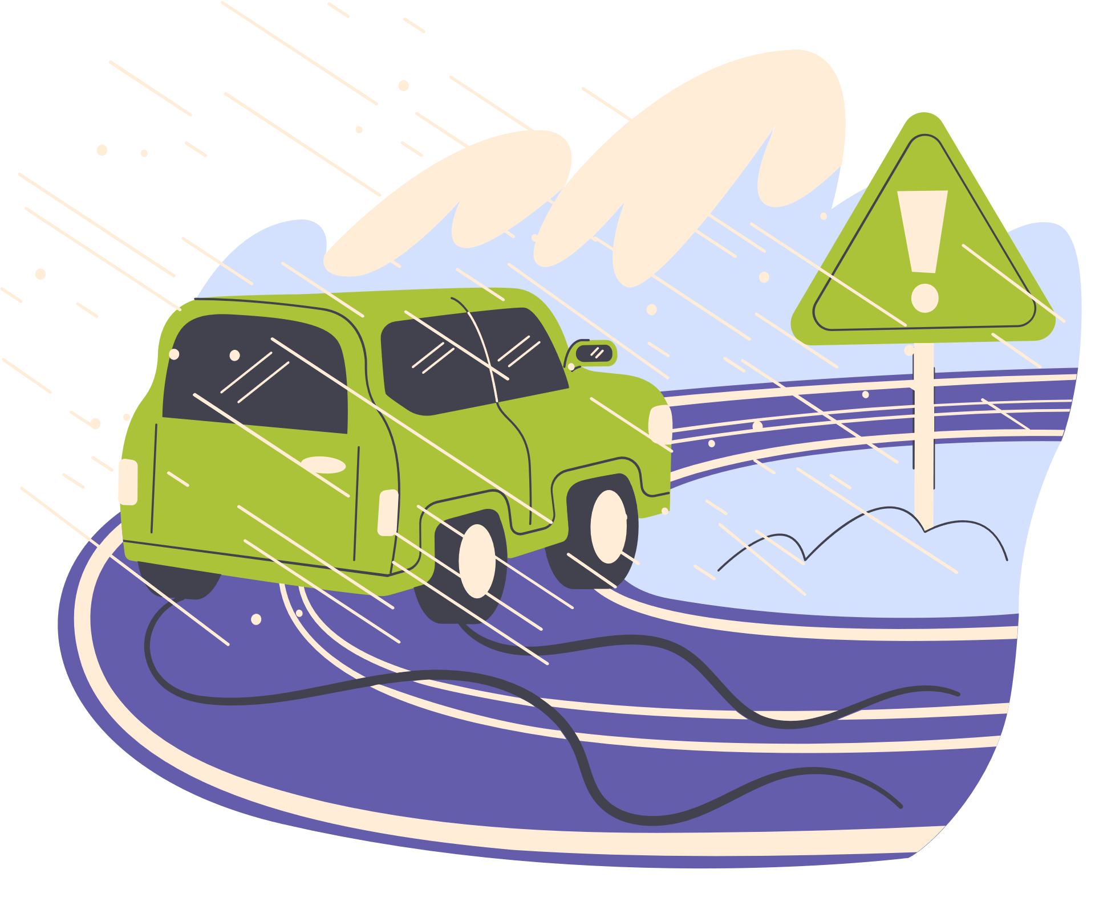





Environmental Impacts
Environmental impacts of climate change include rising global temperatures, melting polar ice caps, rising sea levels, and changing weather patterns.

Slide 13

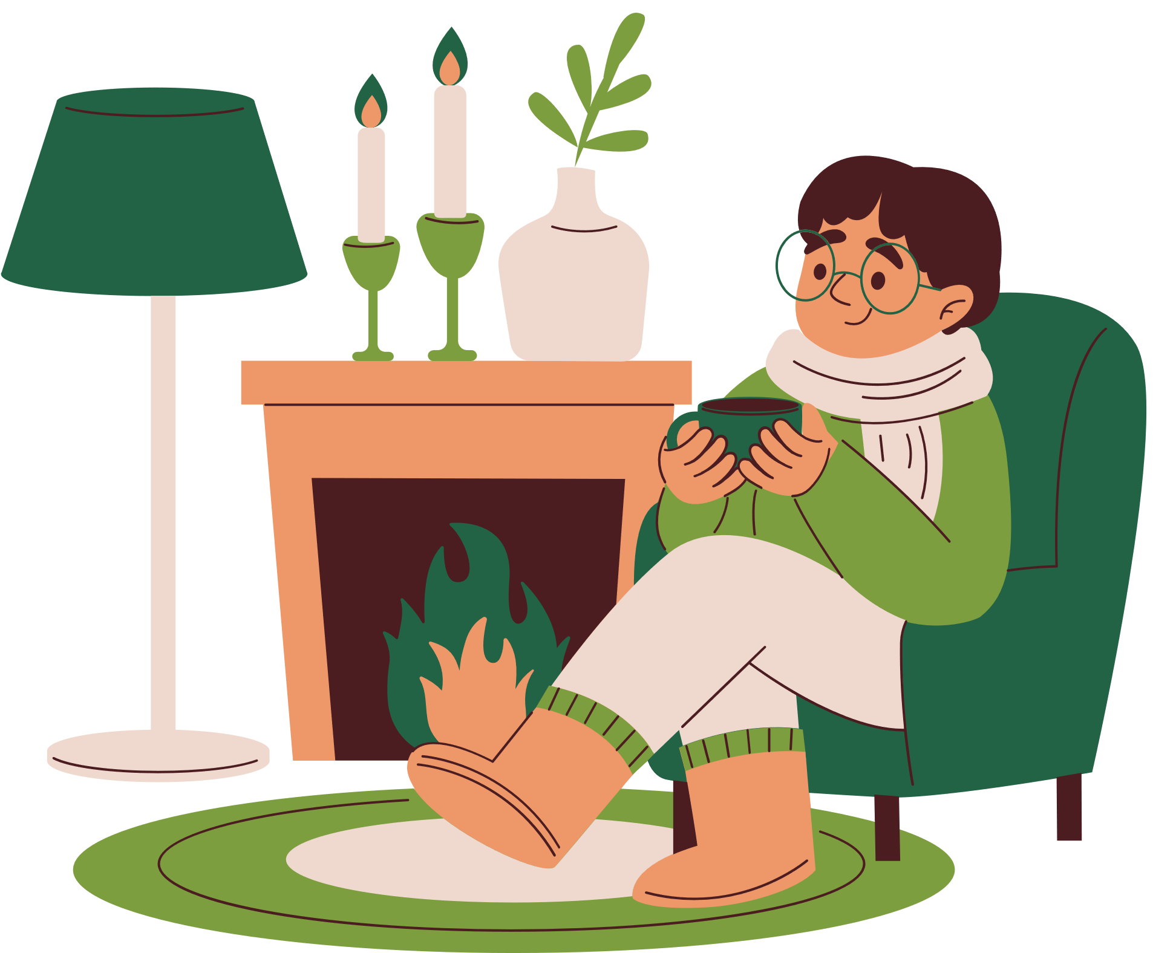




Renewable Energy
One of the main solutions to addressing climate change is the transition to renewable energy such as solar, wind, and hydropower. These energies produce fewer emissions and are key to a sustainable future.

Slide 14

Question 3:
Which of the following is a form of renewable energy?
Coal
Solar
Oil
Natural Gas

Slide 15







Climate Change Mitigation
Using clean energy is like riding a bike instead of driving a car. The bike doesn’t create pollution, so it’s better for the environment. Clean energy, like solar panels and wind turbines, works the same way—it powers our homes without polluting the air
Climate Change Mitigation means taking steps to slow down climate change, like fixing a problem before it gets worse.
Imagine spilling juice on the table. If you use a sponge to soak it up, the table stays clean. Trees act like a sponge for carbon dioxide (CO₂), soaking it up and keeping the air clean. The more trees we plant, the more CO₂ we can "clean up"

Slide 16


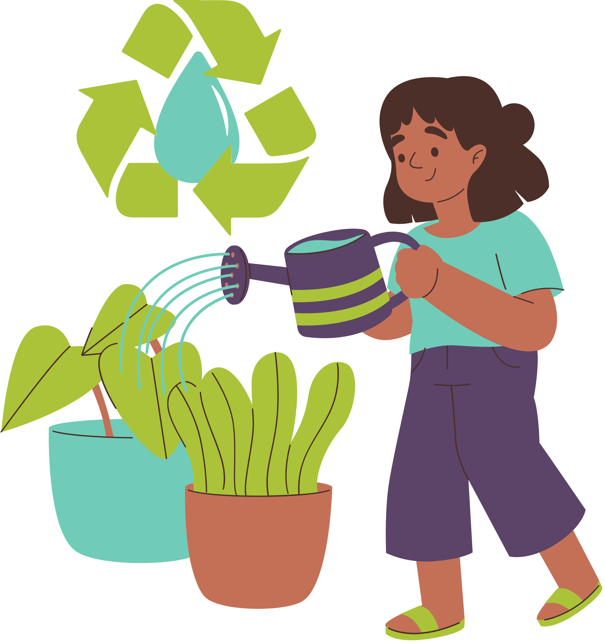

Mitigation Strategy
Other mitigation strategies include increasing energy efficiency, reforestation, and changing consumption and production patterns.
Every individual can contribute by reducing their carbon footprint.

Slide 17
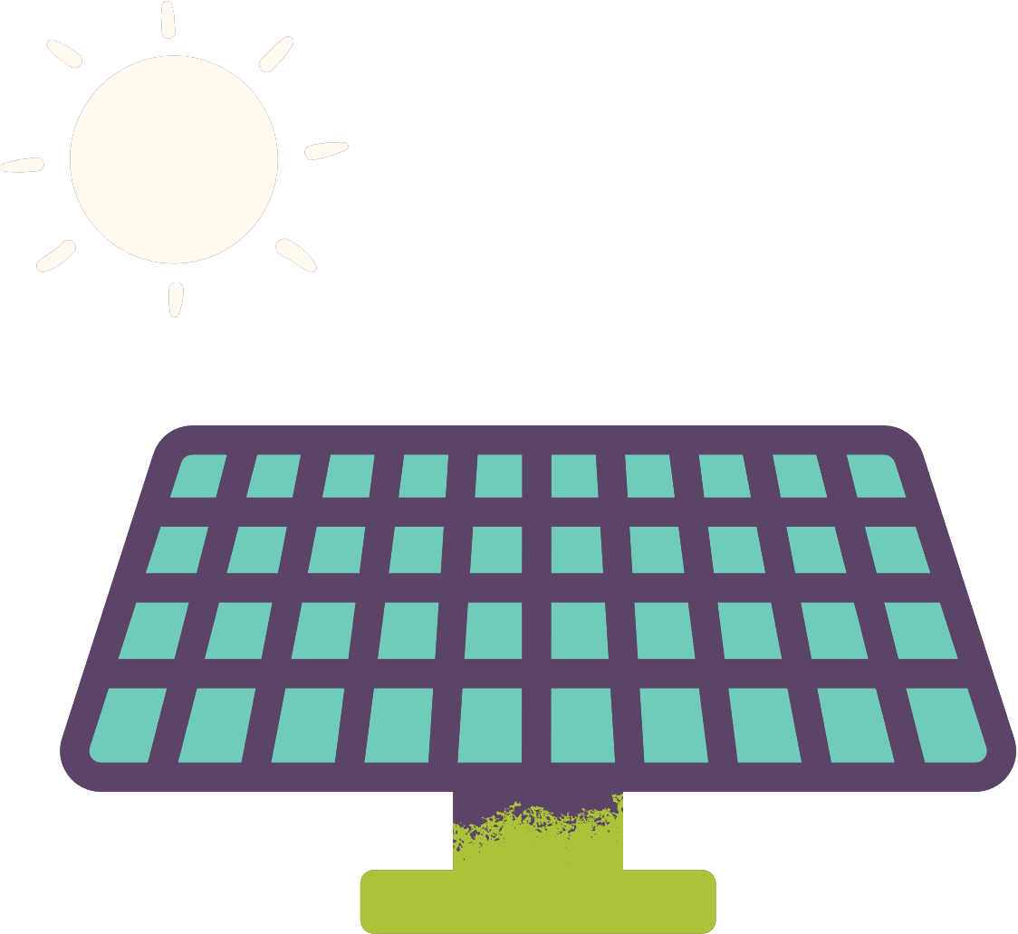



Adaptation Strategy
In addition to mitigation, we need to adapt to the inevitable impacts of climate change.
This includes building climate resilient infrastructure, protecting ecosystems, and better land use planning.

Slide 18
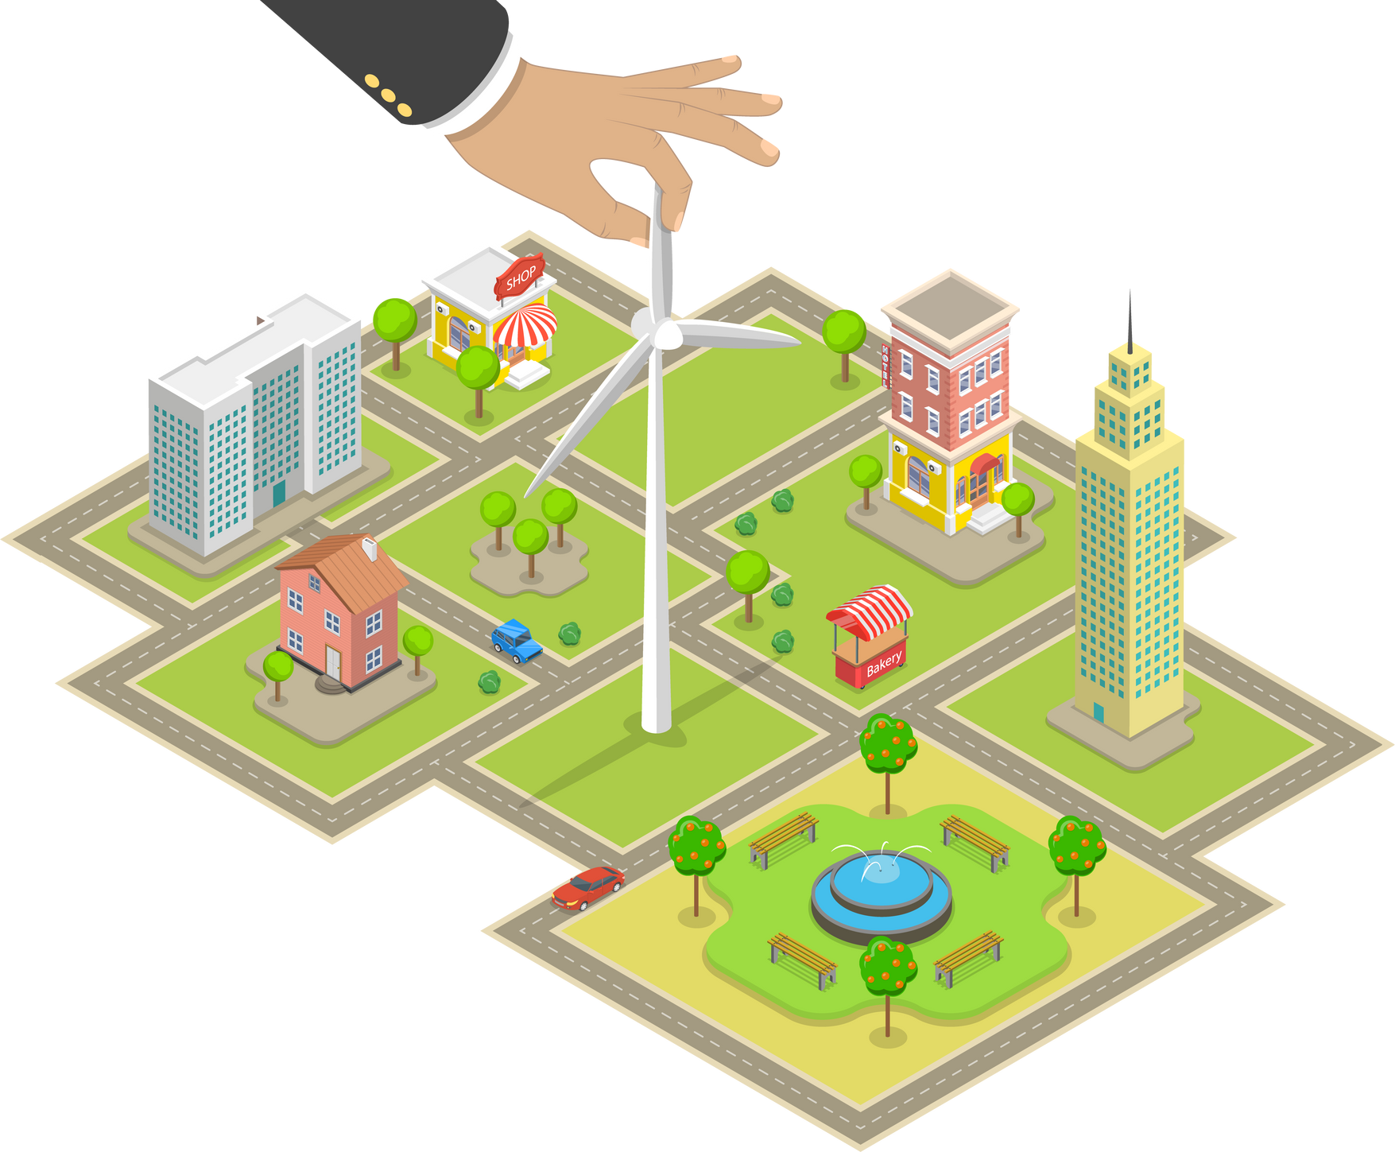

Climate Change Adaptation
Climate Change Adaptation means preparing for the changes that are already happening because of climate change, like finding ways to stay safe and live better in a changing world.
On a hot day, you might sit under a tree or use a fan to cool down. Cities do the same by planting trees, creating green spaces, or painting roofs white to reflect heat and make neighborhoods cooler

Slide 19


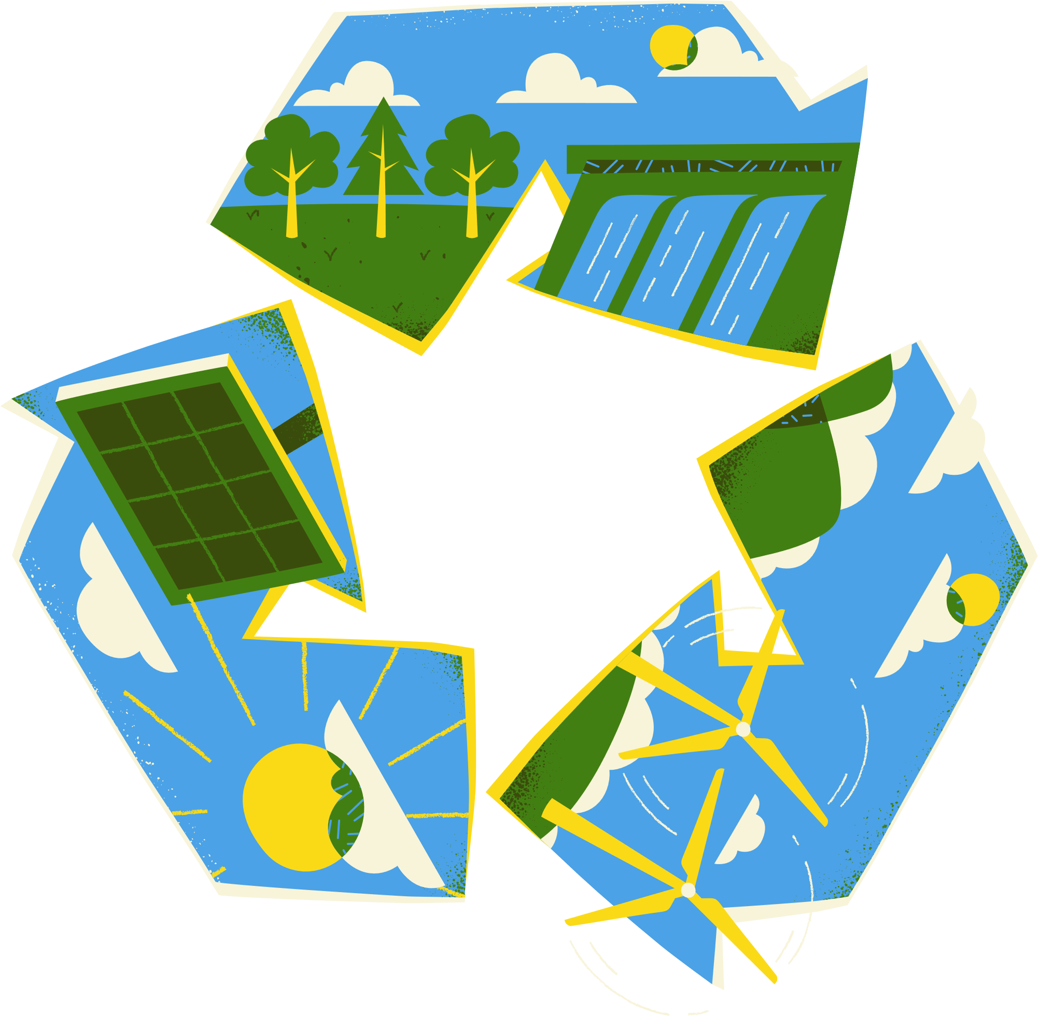
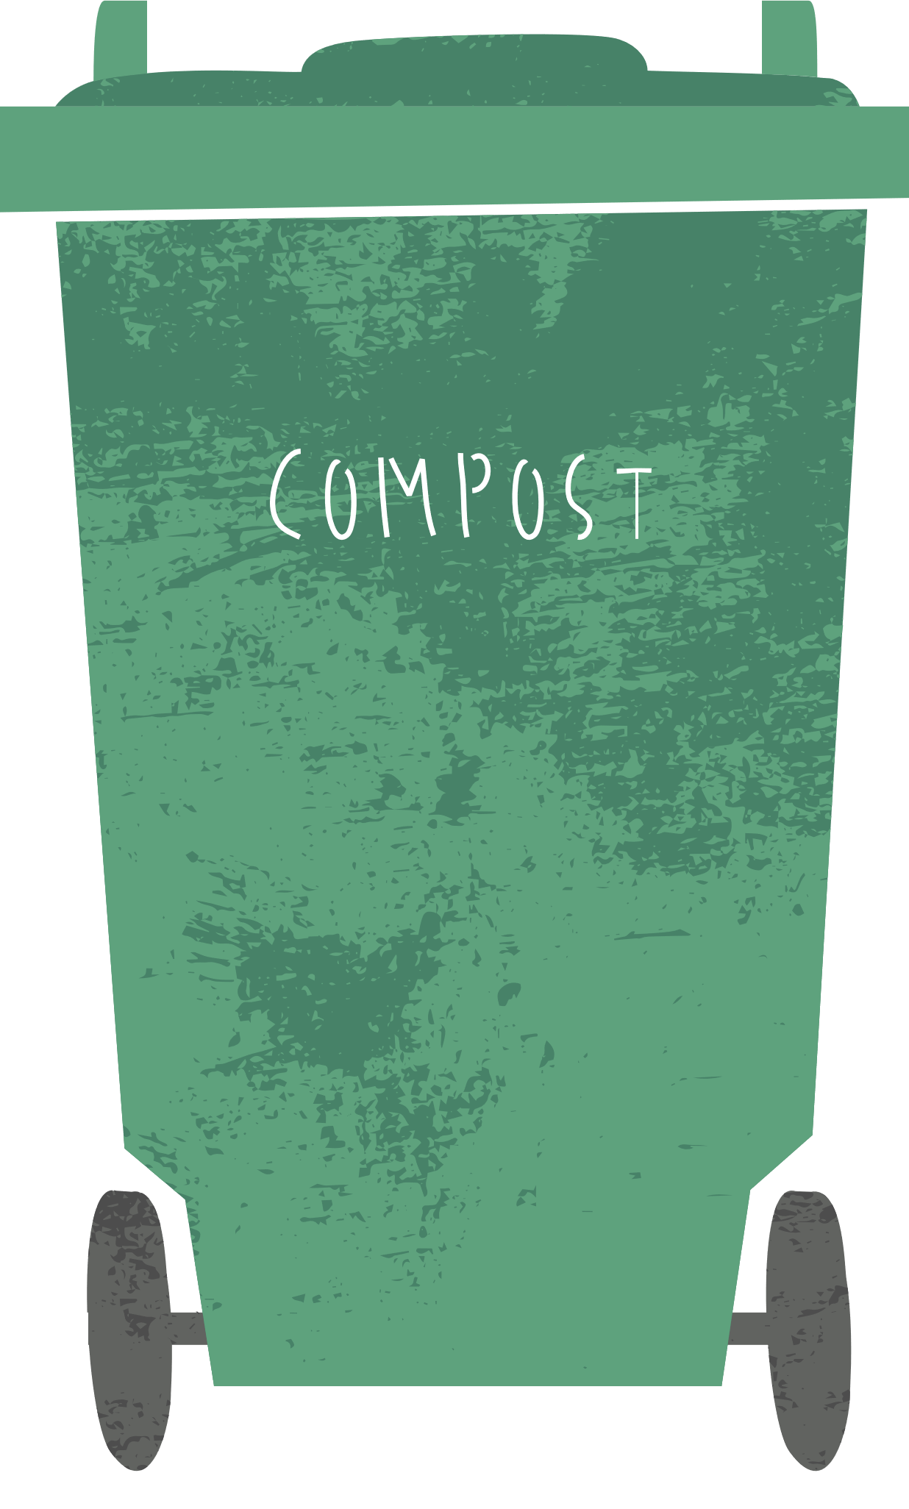
Question 4:
Waste reduction, active transportation and renewable energy would be all considered…
Climate Change Adaptation
Climate Change Mitigation
Greenhouse Effect

Slide 20

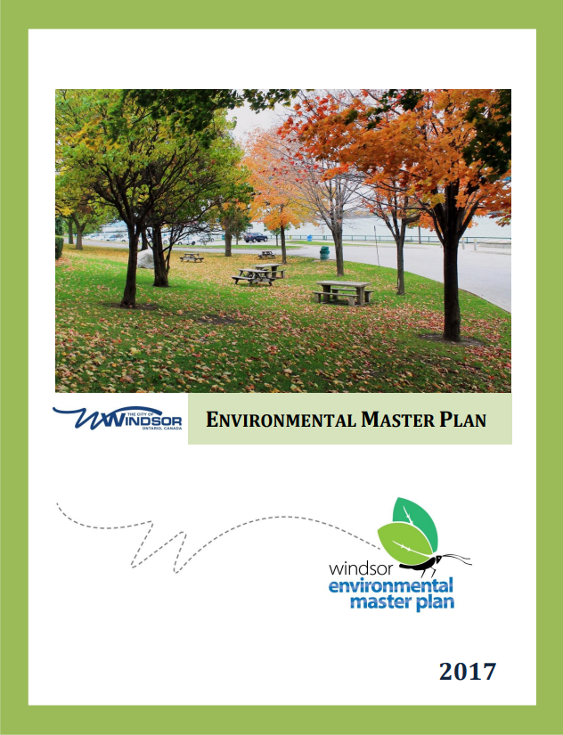
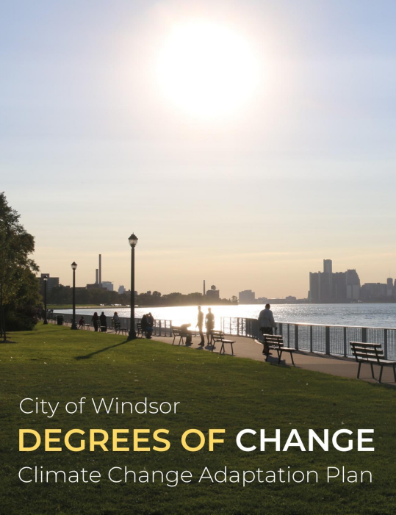
How is the CIty of Windsor fighting climate change?

Slide 21

Community Energy Plan
Actions include:
  Retrofitting old buildings to reduce energy consumption
  Increasing active transportation opportunities through bike lanes and Transit Windsor routes
  Increasing the number of electric vehicle charging stations across the City
  Implementing Solar projects to power our buildings
  Anti-Idling initiatives and technologies
  Streetlight LED light conversions
  Composting program (launching in 2025)

Slide 22
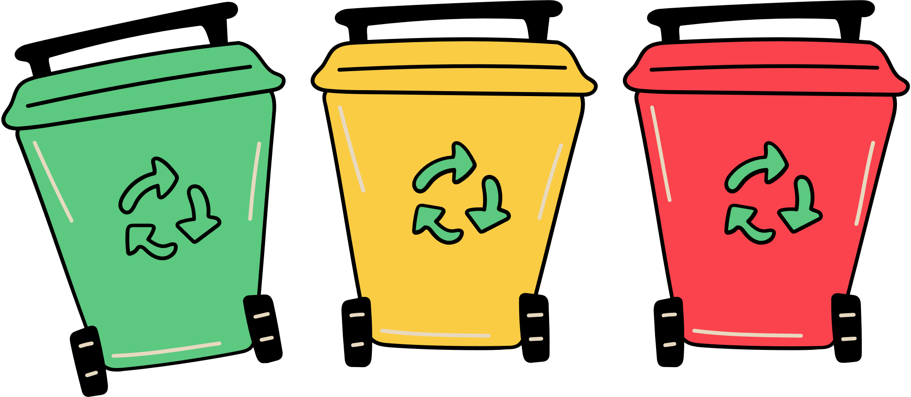
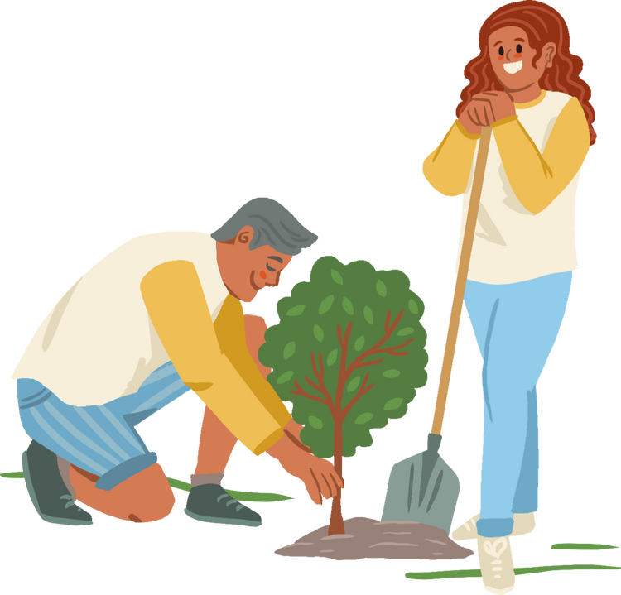


Environmental Master Plan
Actions include:
  Updating the Transit Windsor Master Plan
  Decreasing the use of pesticides in City parks
  Increased tree planting
  Encouraging development on previously developed lands
  Tackling invasive species management
  Increased waste diversion through recycling and composting
  Promoting awareness around the link between environmental and public health
  Bird Friendly City Initiatives

Slide 23
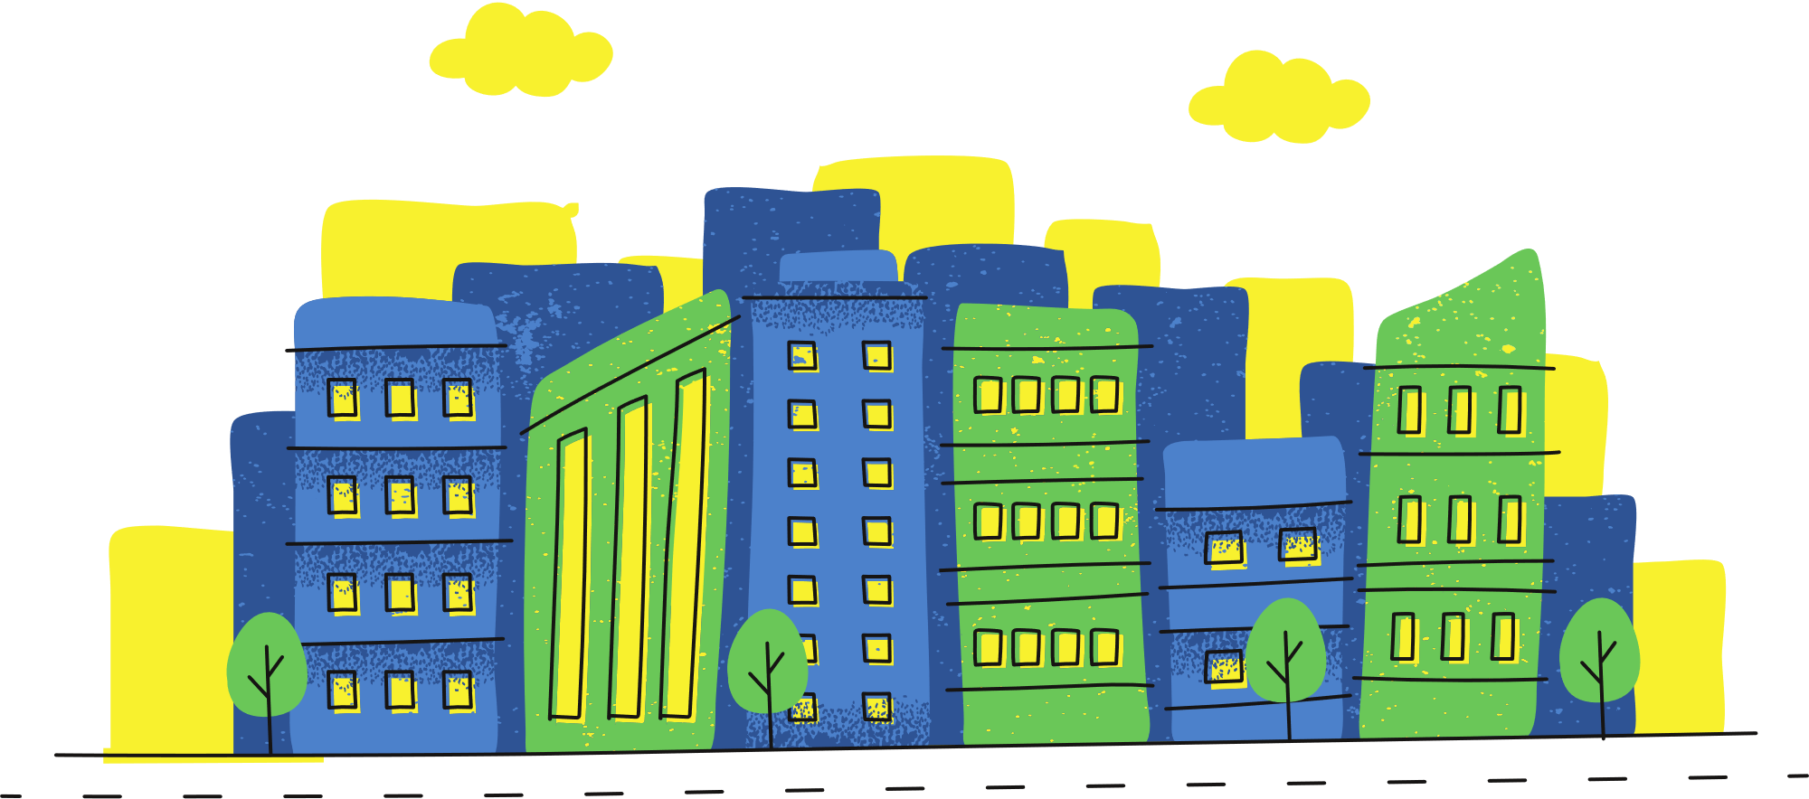
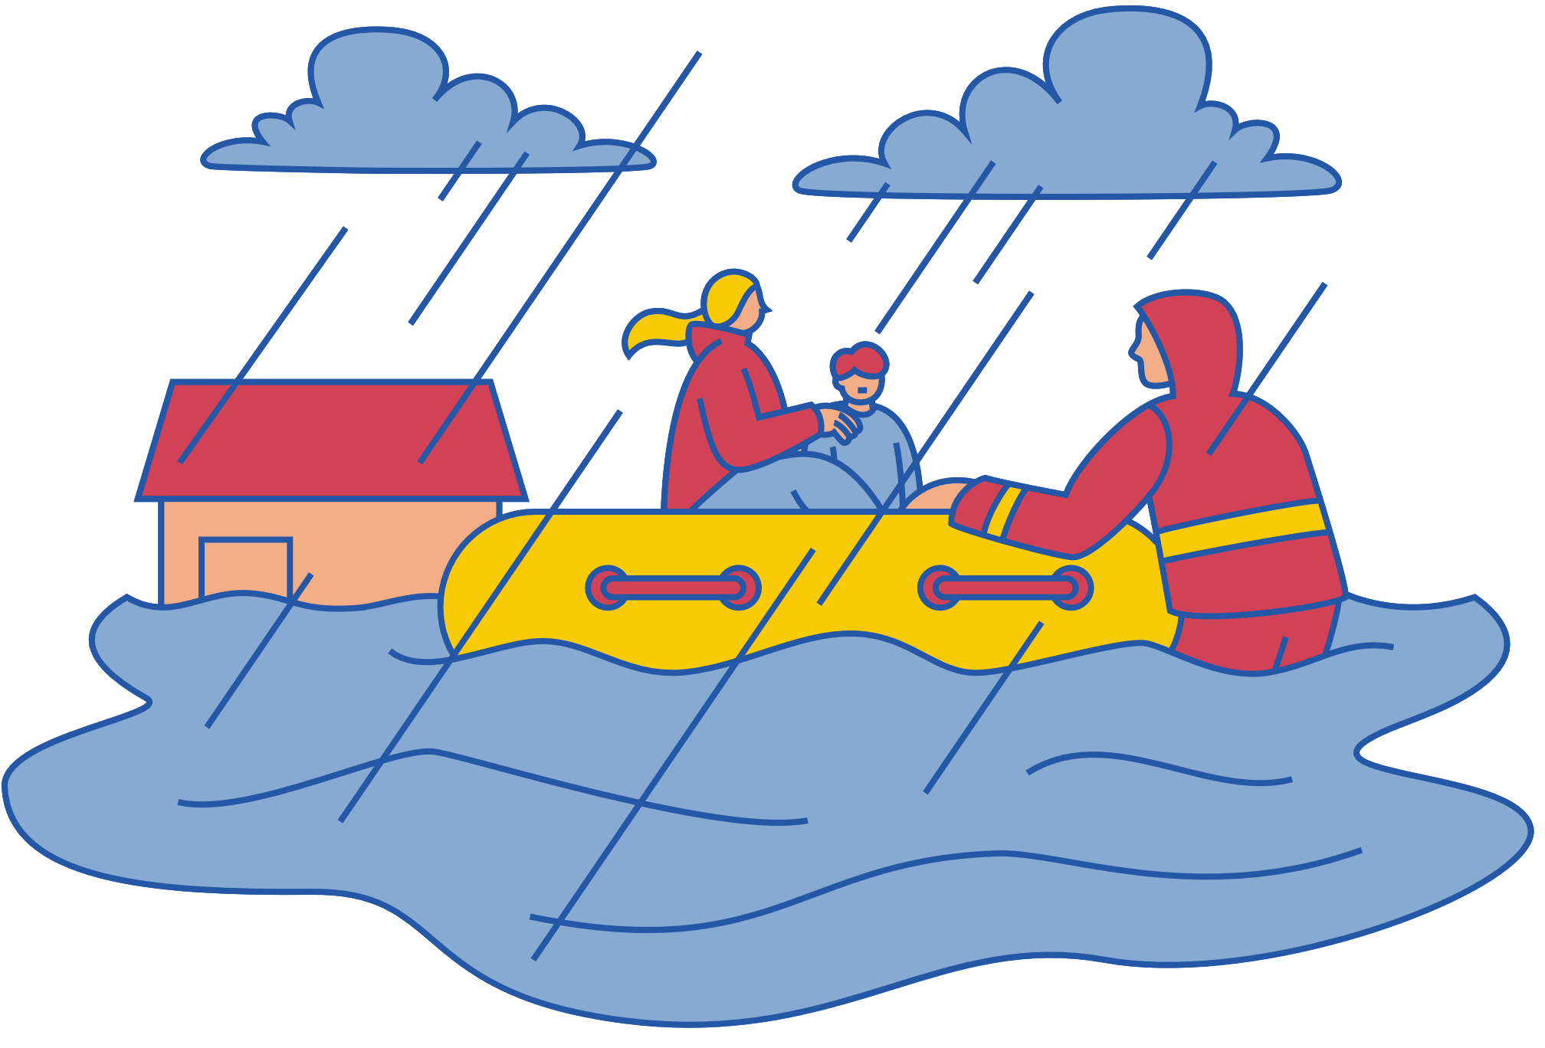
Climate Change Adaptation Plan
Actions include:
  Integration of the Basement Flooding Subsidy Program
  Implementation of the Sewer Master Plan to reduce flooding risks
  Incorporating climate considerations into infrastructure designs
  Promoting green infrastructure options for drainage
  Completion of an Urban Forestry Management Plan
  Improved stormwater designs for future climatic projections in the City
  Integration of low impact development solutions

Slide 24

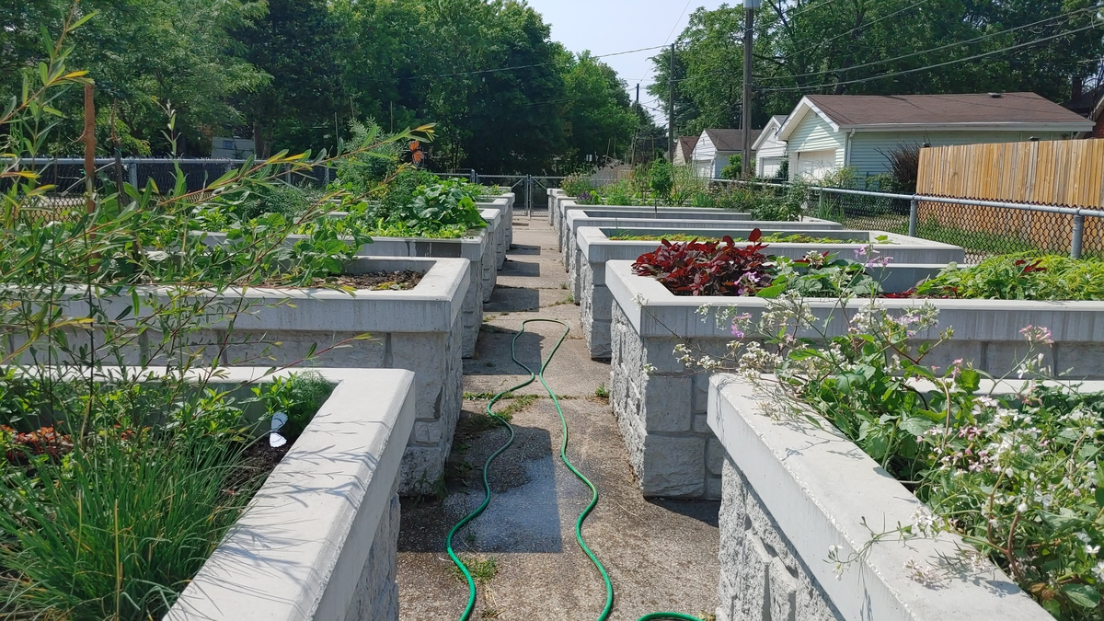
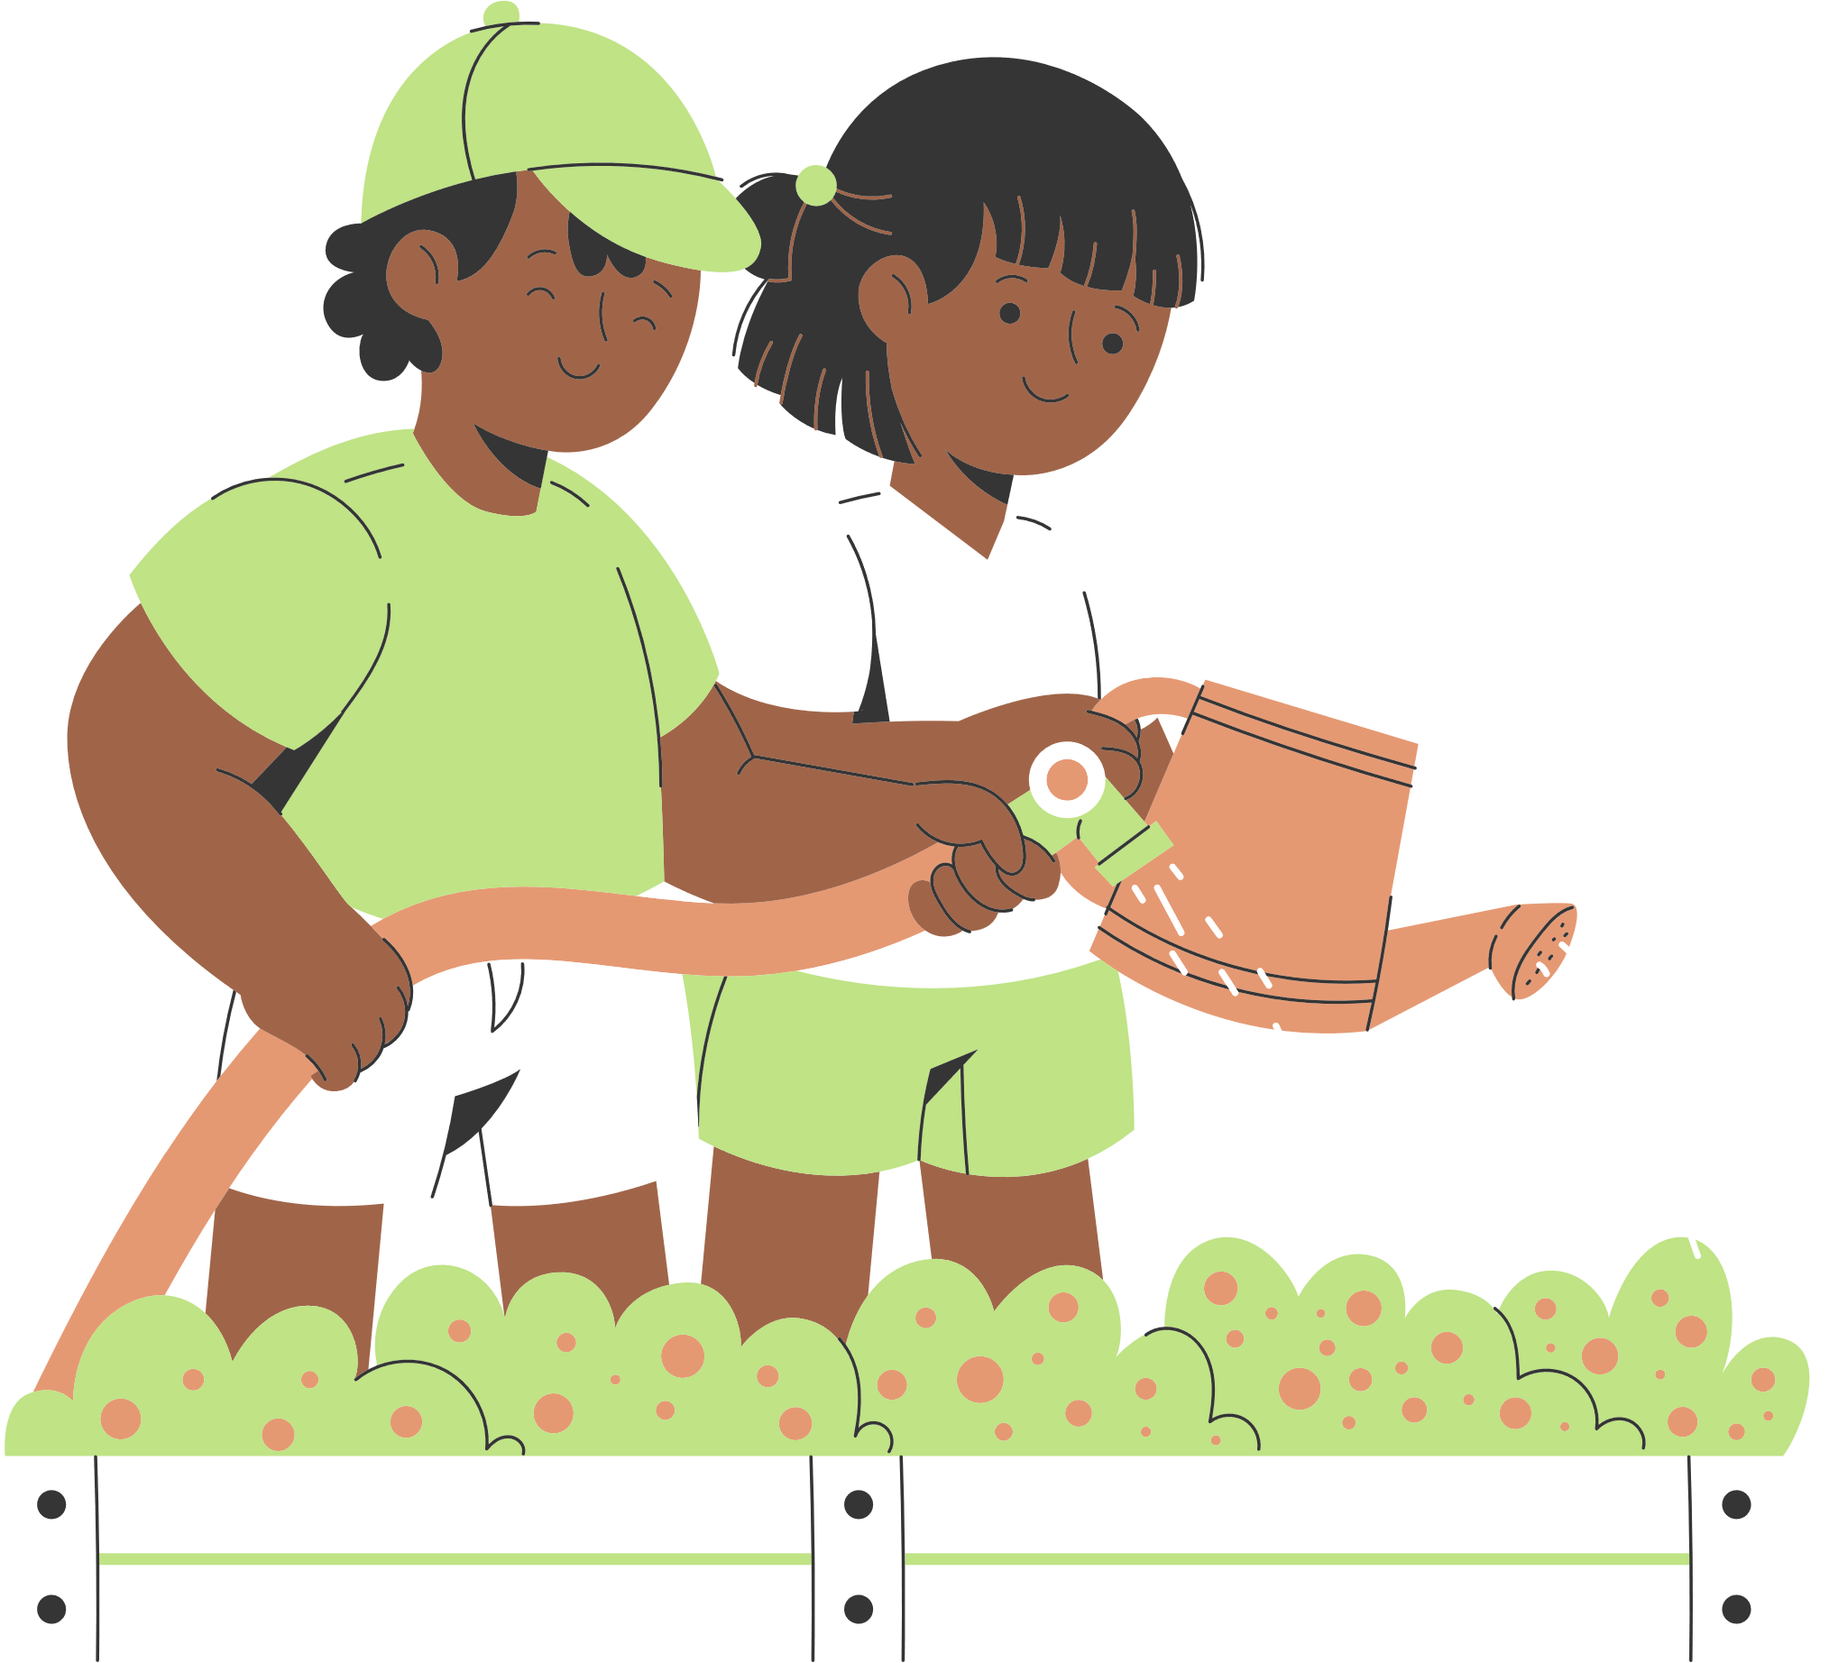
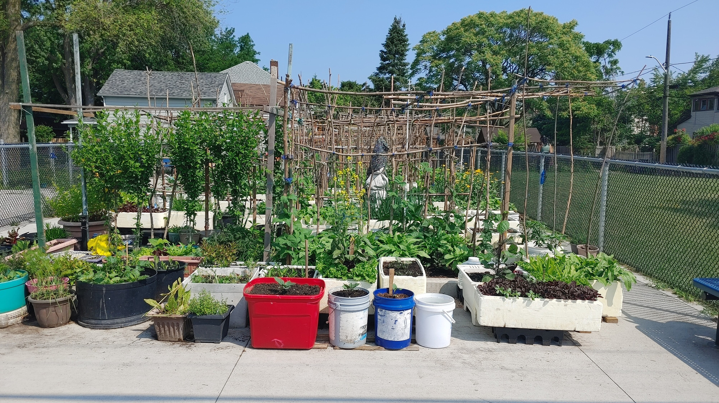
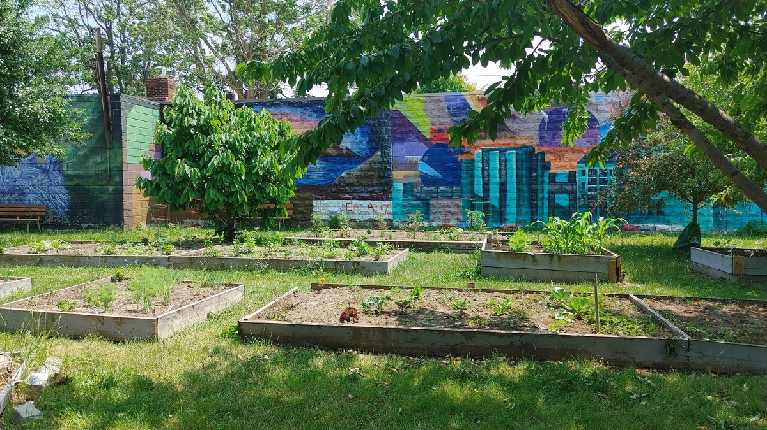

join the City of windsor community gardens

Slide 25
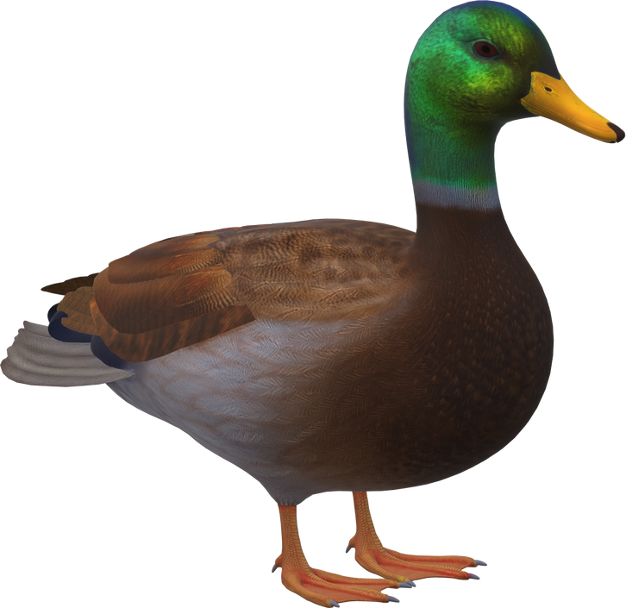
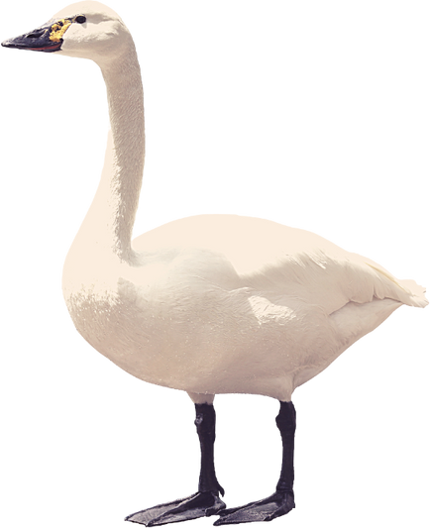
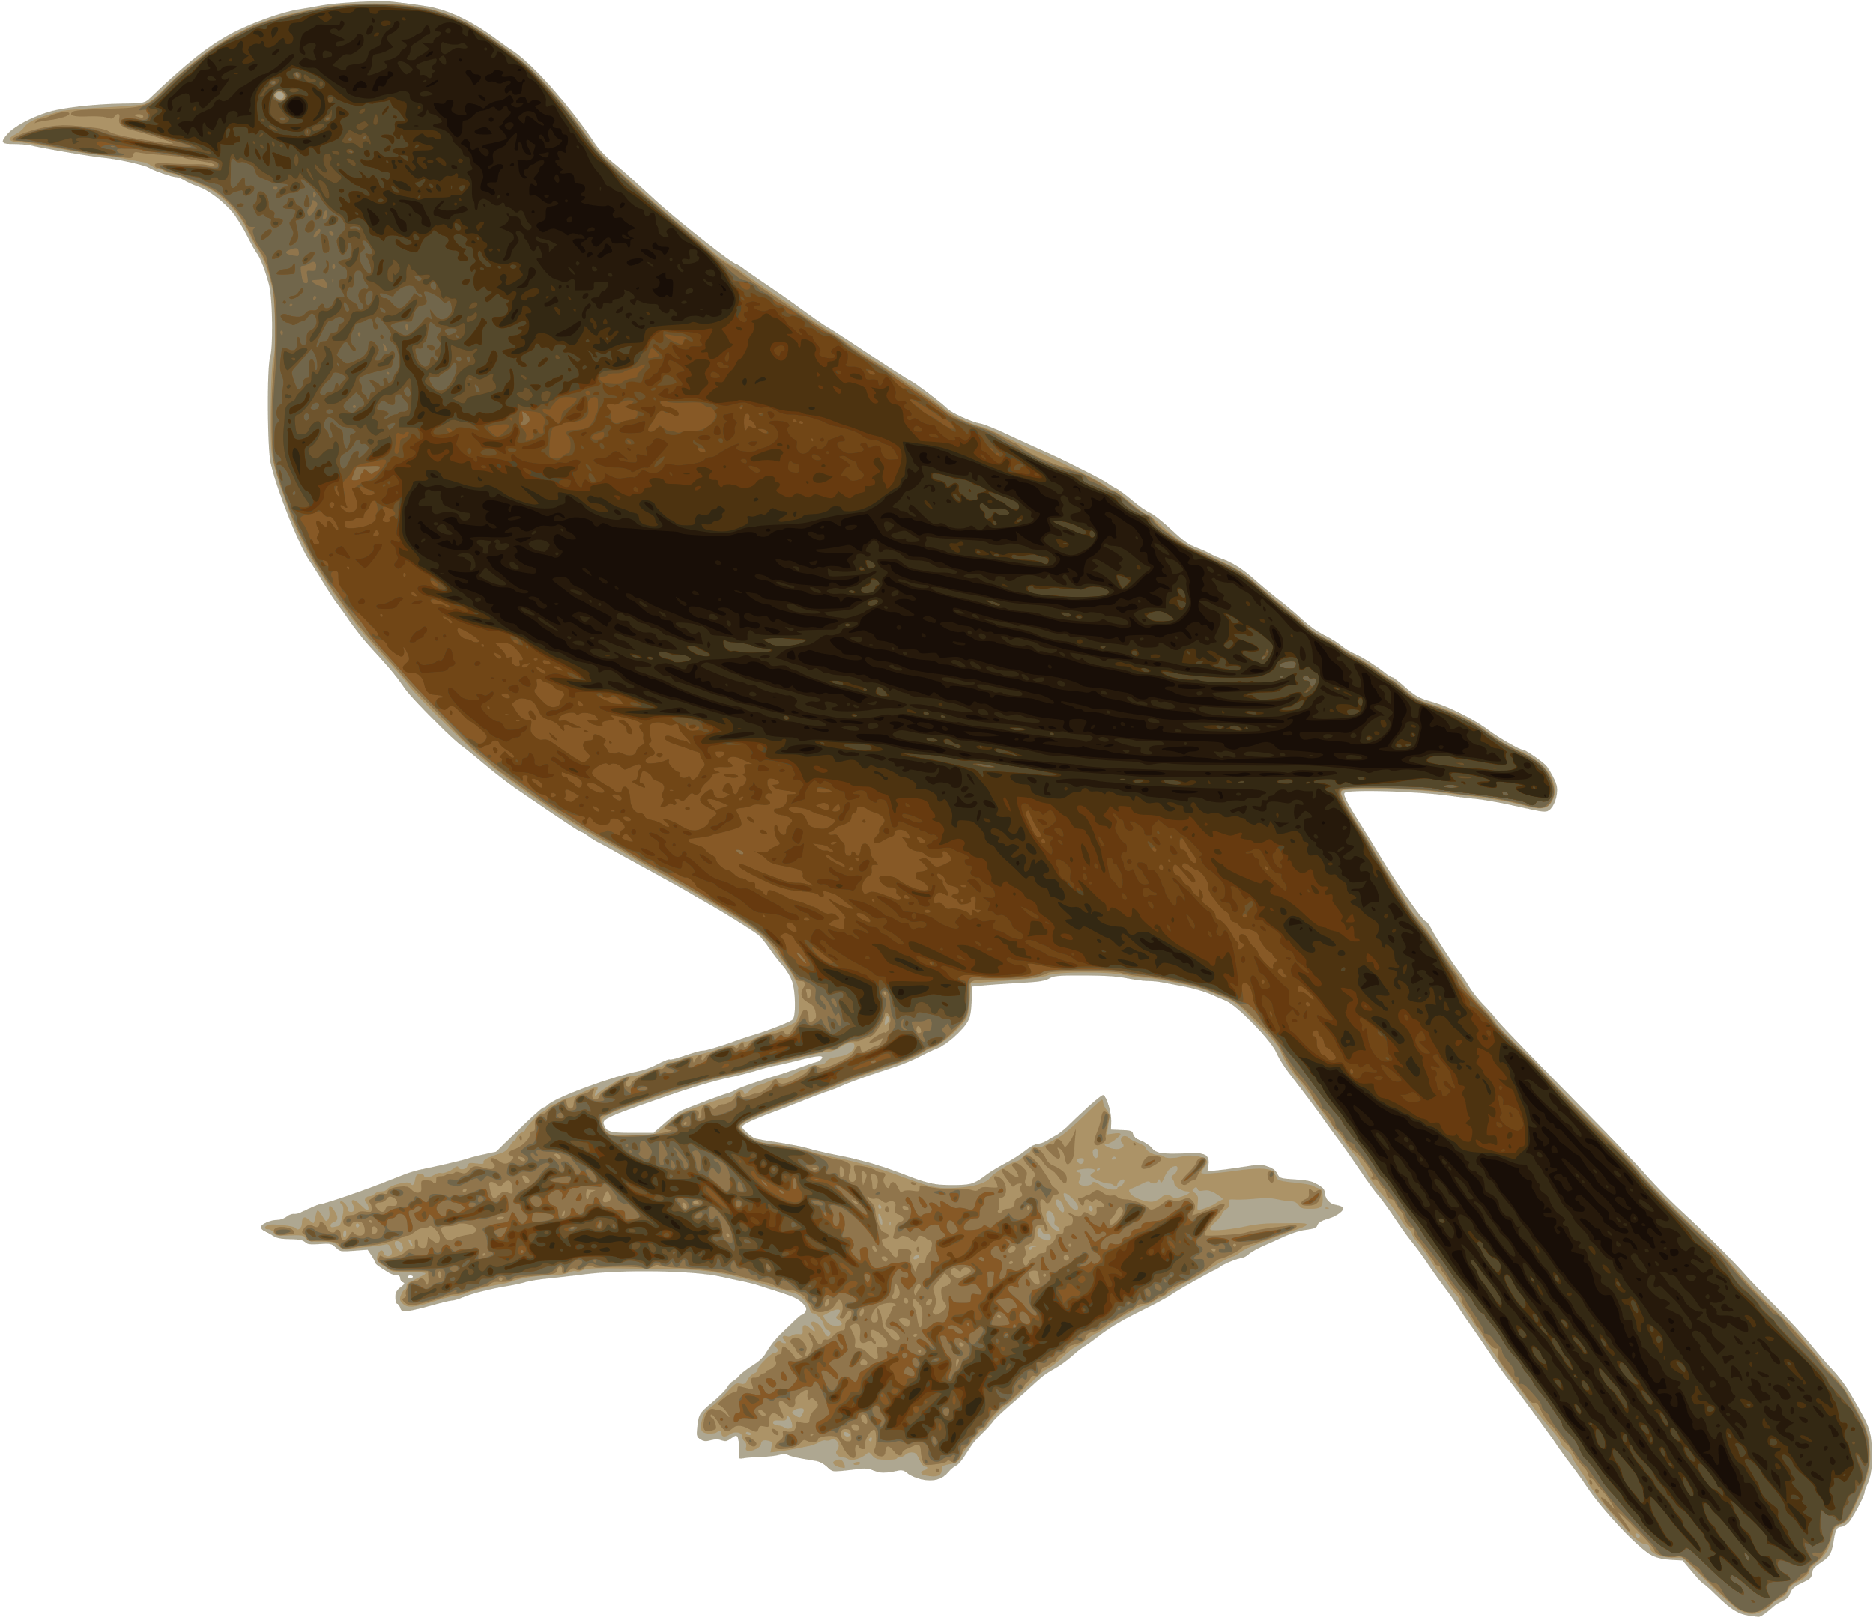

Question 5: bird friendly city initiatives should be considered when tackling actions for which city of Windsor plan?
Environmental Master Plan
Community Energy Plan
Climate Change Adaptation Plan
All of the above

Slide 26

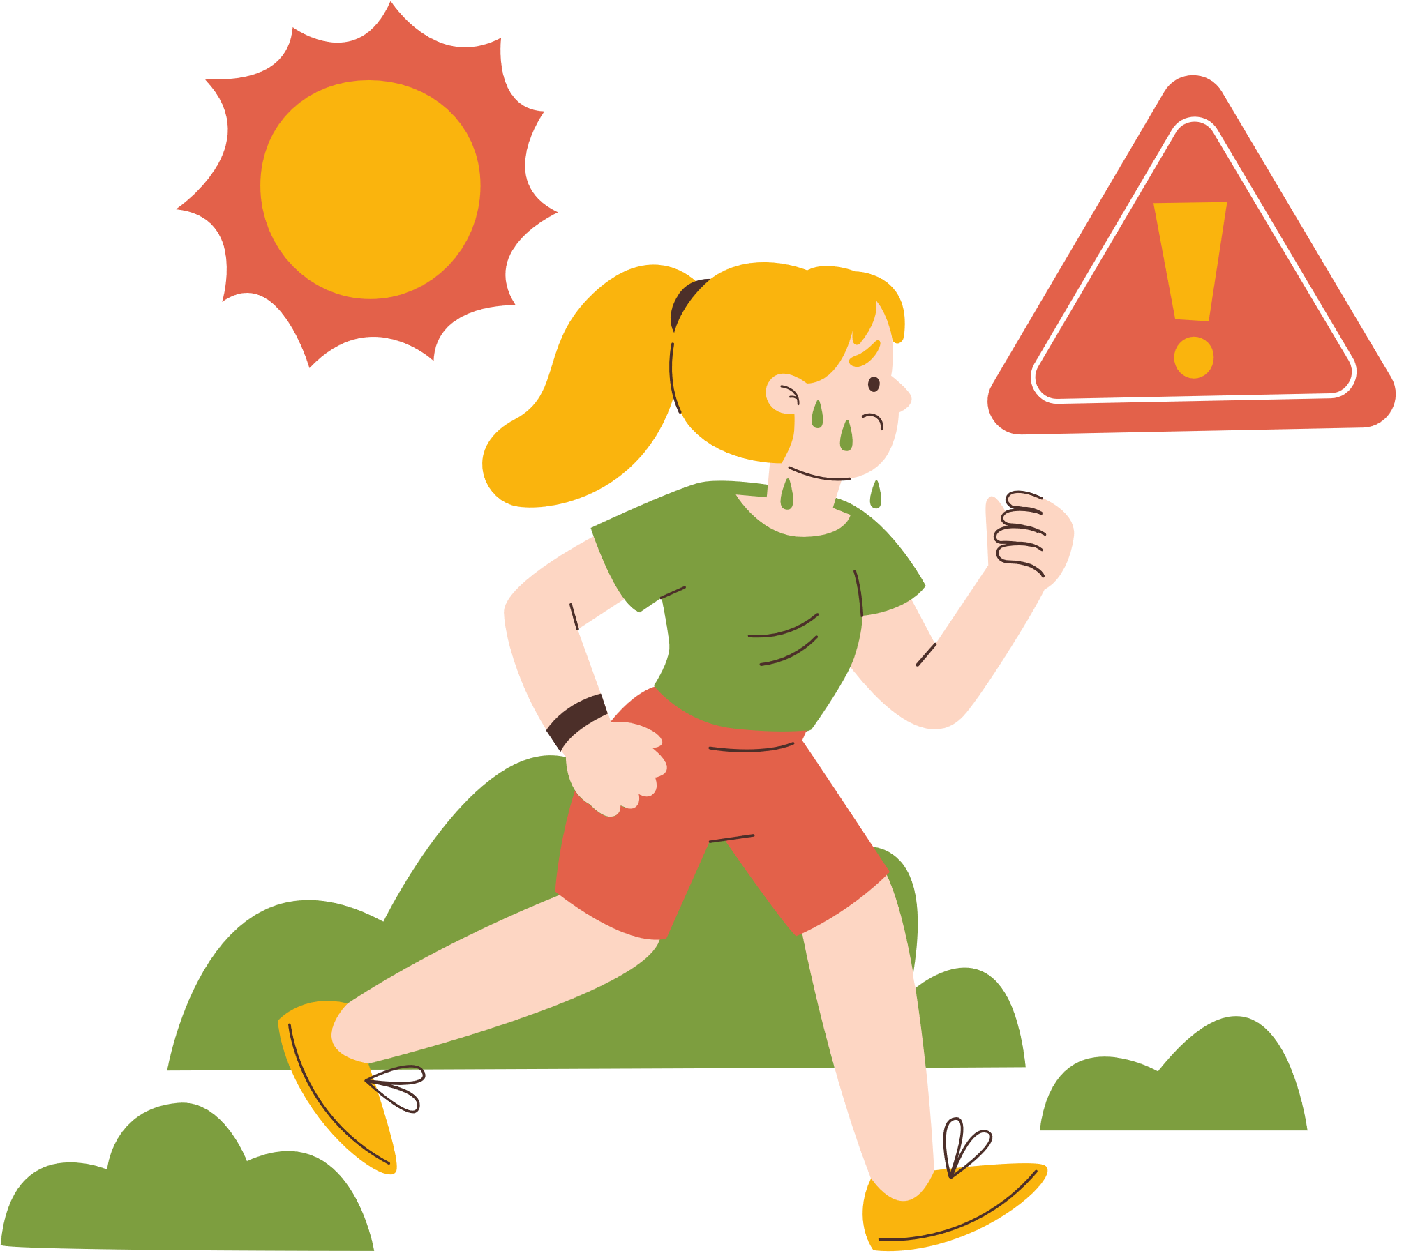


Climate change is a global challenge that requires collective action.
By raising awareness and adopting sustainable measures, we can protect the planet for future generations.

Slide 27





Thank
you

Slide 28









Class activity
let’s make bird friendly window decorations!

Slide 29


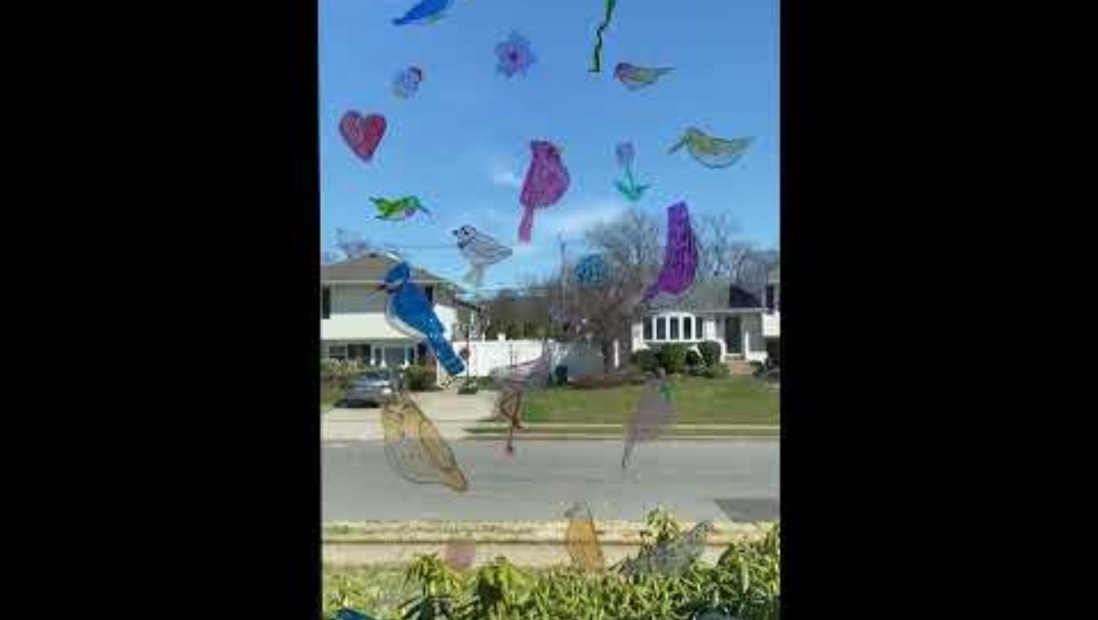




Class activity

Slide 30
Answer Key
True
Flooding
Solar
Climate Change Mitigation
All of the above

