Slide 1
575 RIVERSIDE DR E – OTR 23-5067
Building By-law Officer: Peter Quaglia
Inspection Completed: January 17, 2023
OTR Issued: January 17, 2023
Property Standards Committee Meeting: May 2, 2023

Slide 2
SUMMARY OF EVENTS
January 17, 2023 – Site inspection at 9:00 AM.
Attended property to complete follow up inspection in continued effort to gain compliance at historically problematic property. Observed the multi-unit residential building continues to present as vacant and derelict / neglected for a period of more than 120 days.
I observed the following property standard defects pursuant to By-Law 9-2019:
Sections 1.6 & 1.7
1. Defective concrete block / missing mortar at foundations walls of main building and exterior walls of accessory structure.
2. Defective / missing siding at main building and accessory structure
Sections 1.8 & 3.4
1. Several windows and exterior doors beyond life span and in need of repair / replacement.
2. Defective overhead door to accessory structure.
Sections 1.9, 1.10, 1.11, 1.12
1. Missing handrail at front and rear doors
2. Missing rear exterior stairs; rear 2nd floor deck / balcony / canopy poorly repaired containing defective / deteriorated materials. Permit with engineer's report / scope of work required for required repairs / replacement.
Section 1.14
1. Defective asphalt roof, soffits and fascia.
Sections 1.15 & 1.32
1. Missing / defective / deteriorated eaves troughs and down spouts throughout.
Order to Repair issued and sent registered mail same day as inspection with compliance date of February 16, 2023.
575 RIVERSIDE DR E - OTR 23-5067

Slide 3
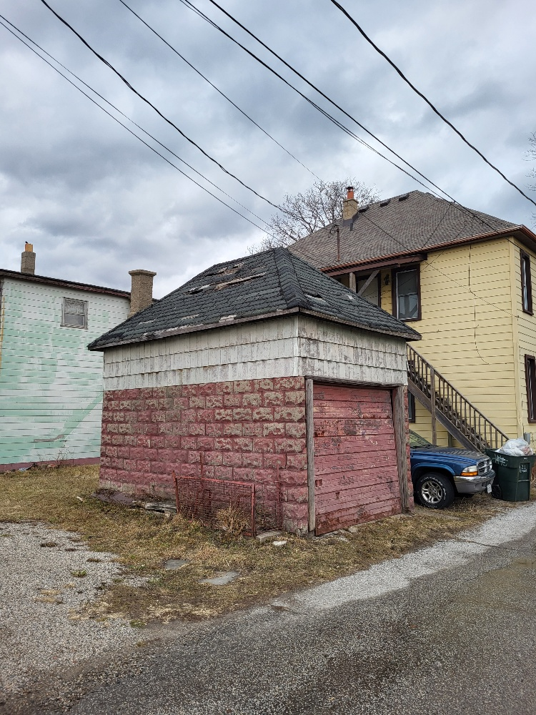
1. Rear accessory structure.
575 RIVERSIDE DR E - OTR 23-5067

Slide 4
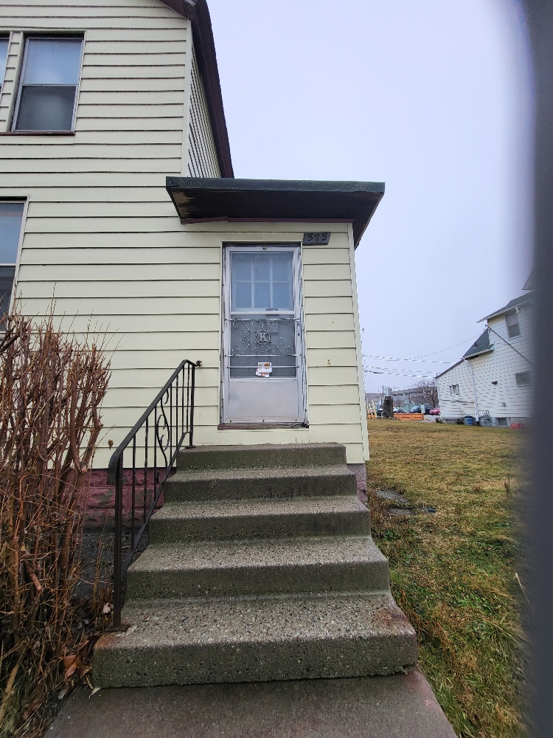
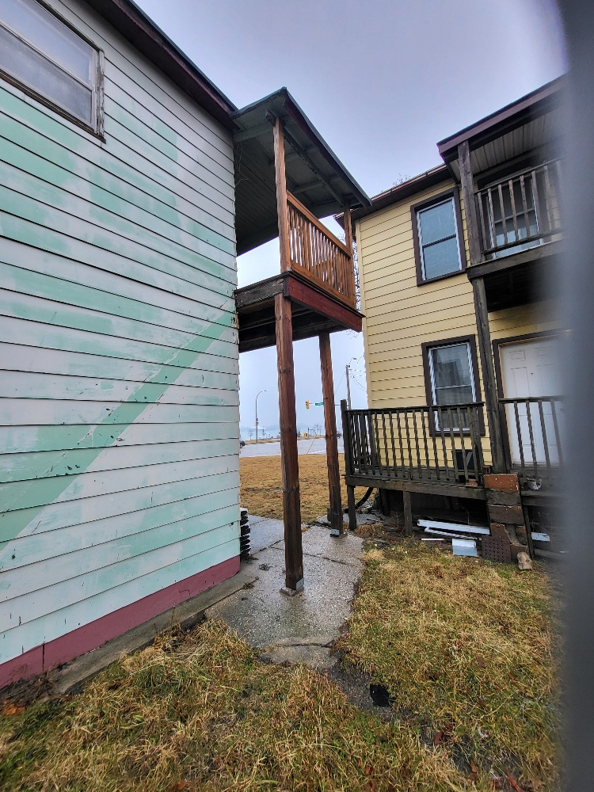
2. Front of building (North elevation).
3. Rear of building (South elevation).
575 RIVERSIDE DR E - OTR 23-5067

Slide 5
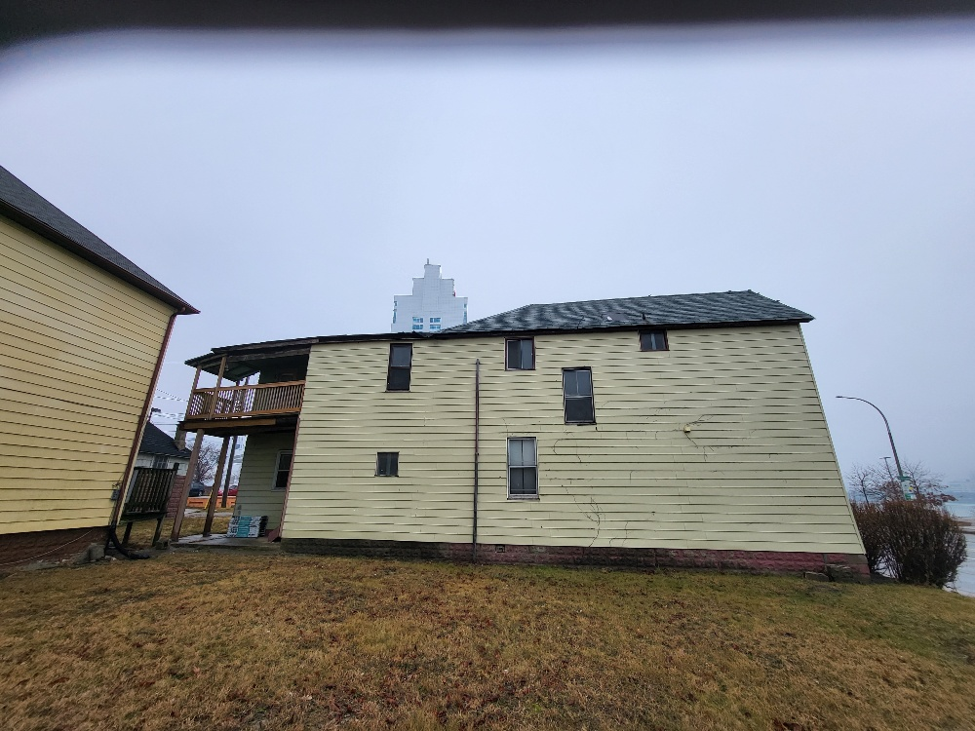
4. Side of building (East elevation).
575 RIVERSIDE DR E - OTR 23-5067

Slide 6
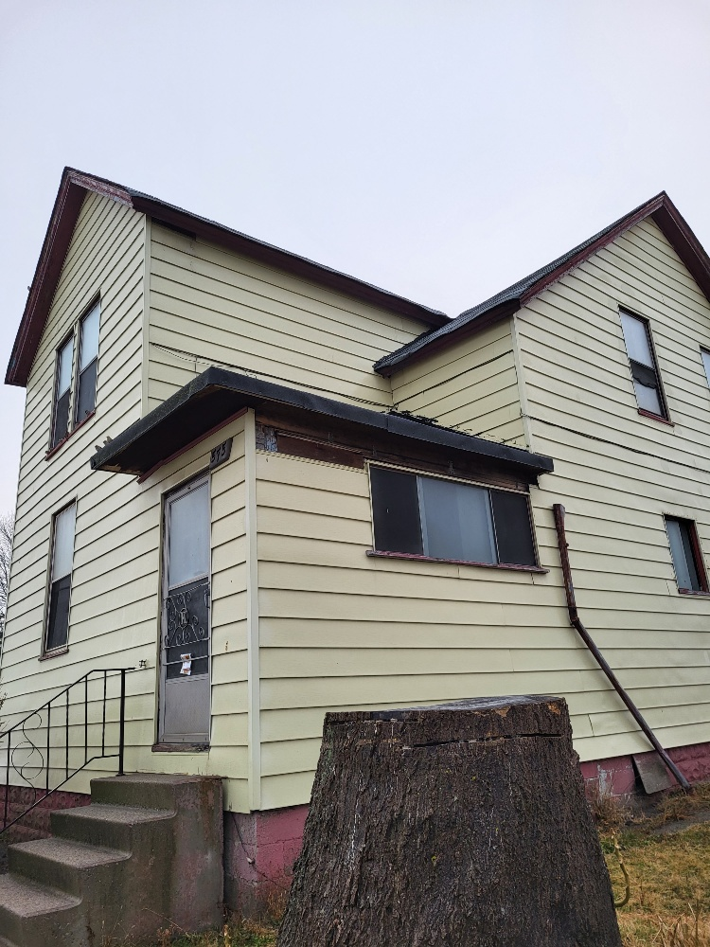
5. Side of building (West elevation).
575 RIVERSIDE DR E - OTR 23-5067

Slide 7
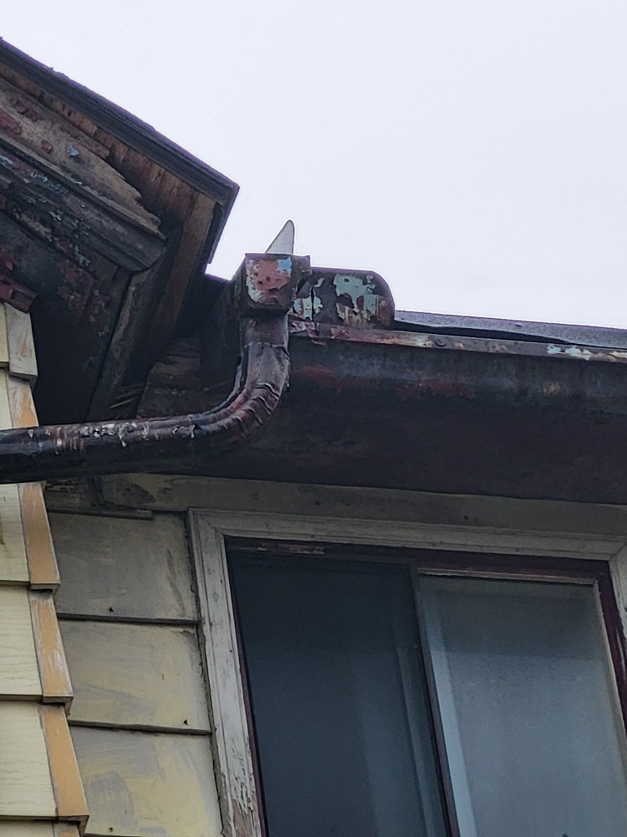
6. Roof line close up at side of building (West elevation).
575 RIVERSIDE DR E - OTR 23-5067

Slide 8
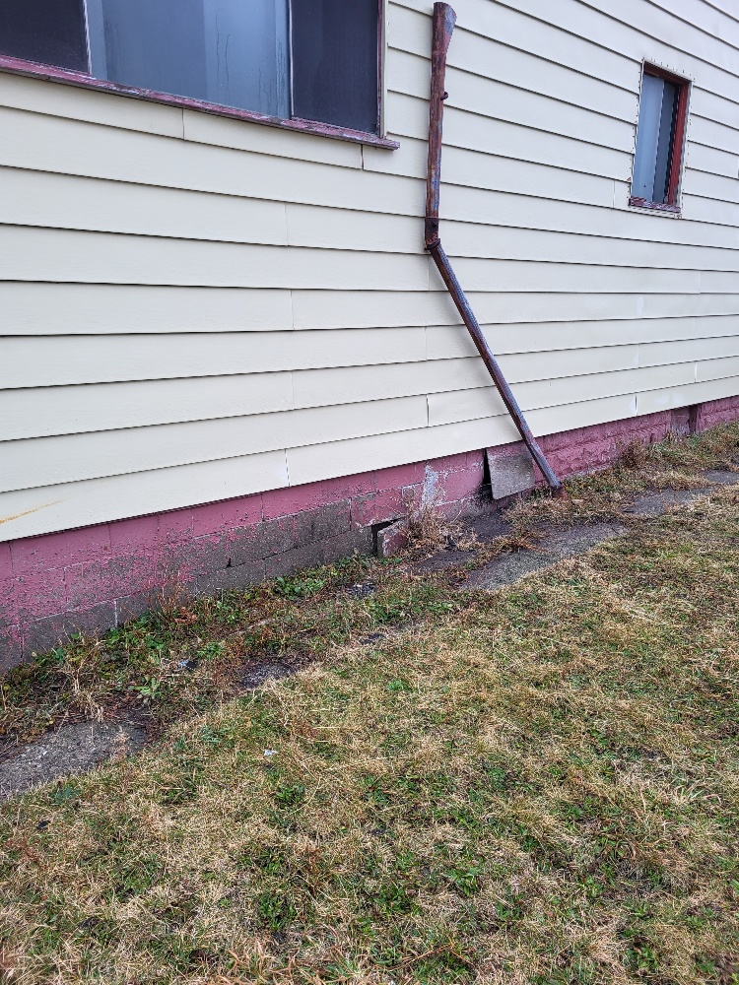
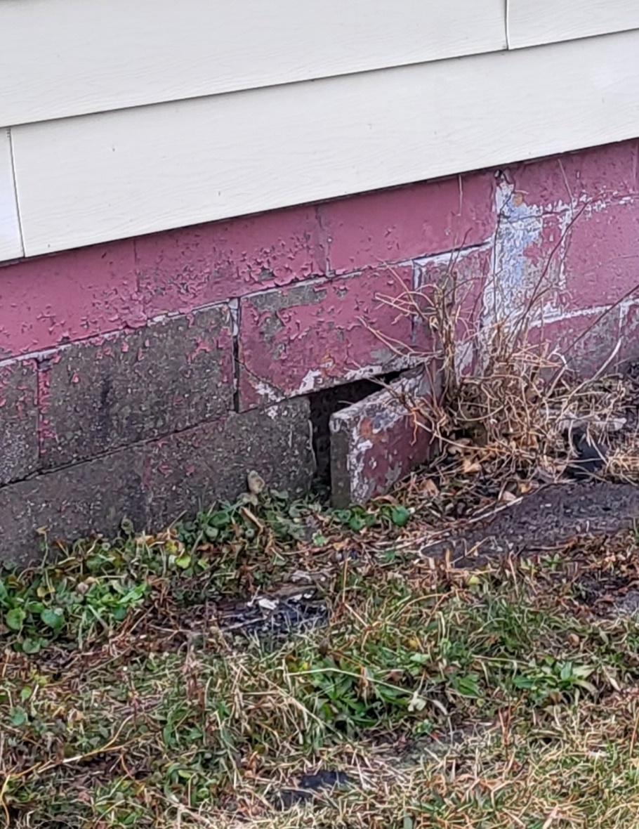
7. Side of building (West elevation).
8. Foundation wall close up at side of building (West elevation).
575 RIVERSIDE DR E - OTR 23-5067

Slide 9
CURRENT COMPLIANCE STATUS
Status of defects:
Sections 1.6 & 1.7
1. Defective concrete block / missing mortar at foundations walls of main building and exterior walls of accessory structure.
NO ACTION TAKEN – NOT IN COMPLIANCE.
2. Defective missing siding at main building and accessory structure. NO ACTION TAKEN – NOT IN COMPLIANCE.
Sections 1.8 & 3.4
1. Several windows and exterior doors beyond life span and in need of repair / replacement. NO ACTION TAKEN – NOT IN COMPLIANCE.
2. Defective overhead door to accessory structure. NO ACTION TAKEN – NOT IN COMPLIANCE.
Sections 1.9, 1.10, 1.11, 1.12
1. Missing handrail at front and rear doors. NO ACTION TAKEN – NOT IN COMPLIANCE.
2. Missing rear exterior stairs; rear 2nd floor deck / balcony / canopy poorly repaired containing defective / deteriorated materials. Permit with engineer's report / scope of work required for required repairs / replacement. NO ACTION TAKEN; NO RECORD OF PERMIT APPLICATION IN CLOUDPERMIT OR AMANDA – NOT IN COMPLIANCE.
Section 1.14
1. Defective asphalt roof, soffits and fascia. NO ACTION TAKEN – NOT IN COMPLIANCE.
Sections 1.15 & 1.32
1. Missing / defective / deteriorated eaves troughs and down spouts throughout. NO ACTION TAKEN – NOT IN COMPLIANCE.
575 RIVERSIDE DR E - OTR 23-5067

